Slide 1
Computers
By Alfie
7FH

Slide 2
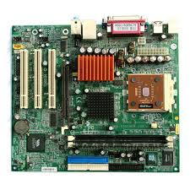
Mother board
The mother board is probably the most important part of the computer. It runs everything. If a drop of water spills on the mother board something on that computer will be ruined. This also holds the important things.

Slide 3
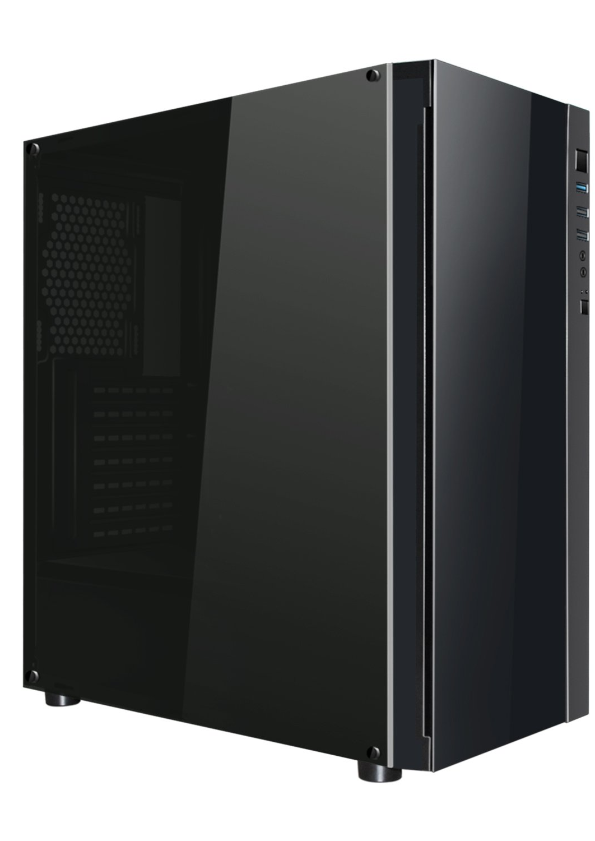
The shell
The shell is really important to a computer. This part of the machine protects anything from getting in. It protects water, dust and insects from getting inside. It also prevents clothes from getting stuck up in the computer which could result in a broken computer.

Slide 4
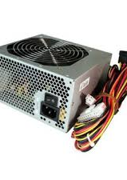
Power supply
The power supply is what gets the computer all of the power. Without it a computer would just be useless. Nothing would work and it would be a waste of materials. If it brakes down while someone is on the computer the computer would just turn off and would not turn back on.

Slide 5
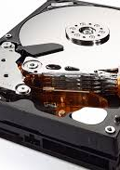
Hard drive
The computer hard drive is what stores all of the computer storage. I t also collects all of the programming and games. It also stores all of your digital content, Pictures, Documents, Downloads.

Slide 6
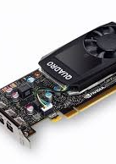
Graphics card
The graphics card sends all of the signals through the motherboard into the monitor. The better the graphics card the better the graphics.

