Slide 1
Inside A Computer!
By Darcey 7FH

Slide 2
The Shell
The shell is on the outside of a computer. It is a big, strong cover used to protect the inside of a computer if you dropped it or just like bash it around. If we didn’t have the shell the computer would probably be broken by now.

Slide 3
The Power Supply
The power supply sends power the computer and all of the other bits inside.
If we didn’t have the power supply there would be no use in using a computer at all.

Slide 4
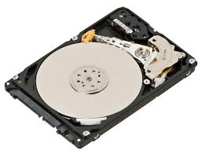
The Hard Drive
The hard drive saves the data from your computer e.g. files and apps. If we didn’t have the hard drive everything on our computer would be gone the next time we come om the computer.

Slide 5
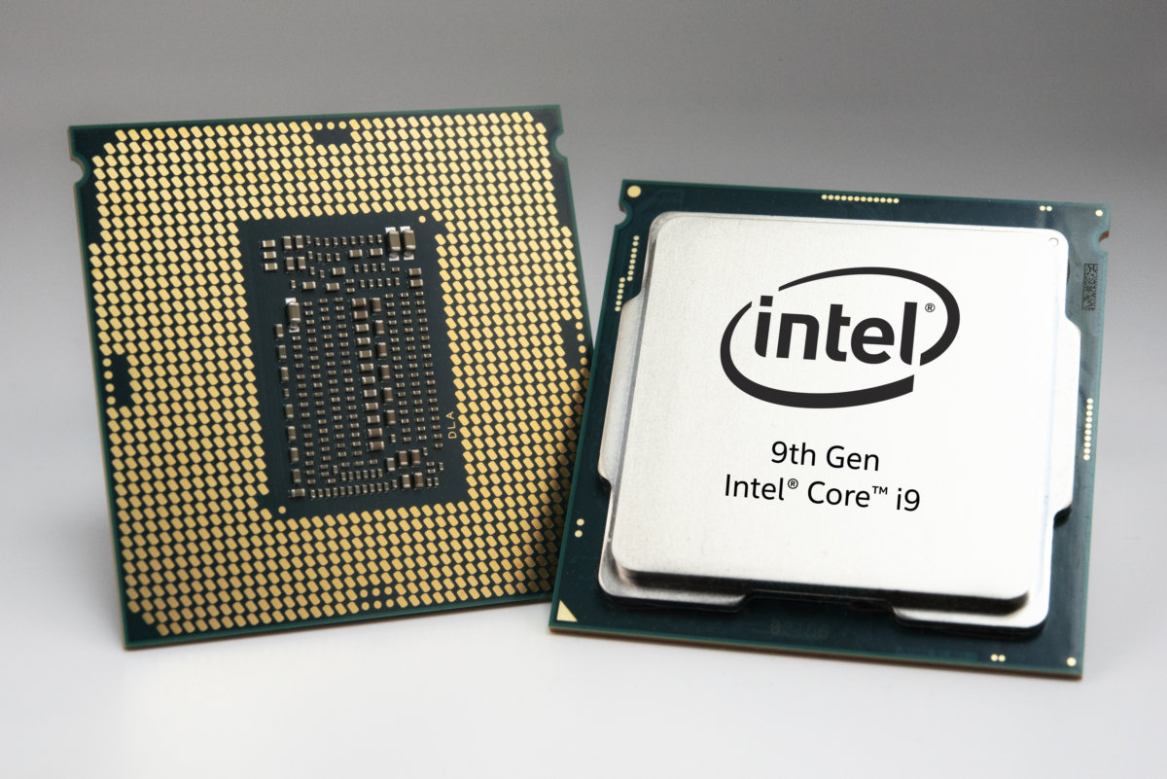
CPU
The CPU the signals around the computer. Without this the computer would be very slow and wouldn’t send the signals around the computer.

Slide 6
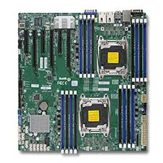
The motherboard
The motherboard passes all the signals to different parts of the computer.

Slide 7
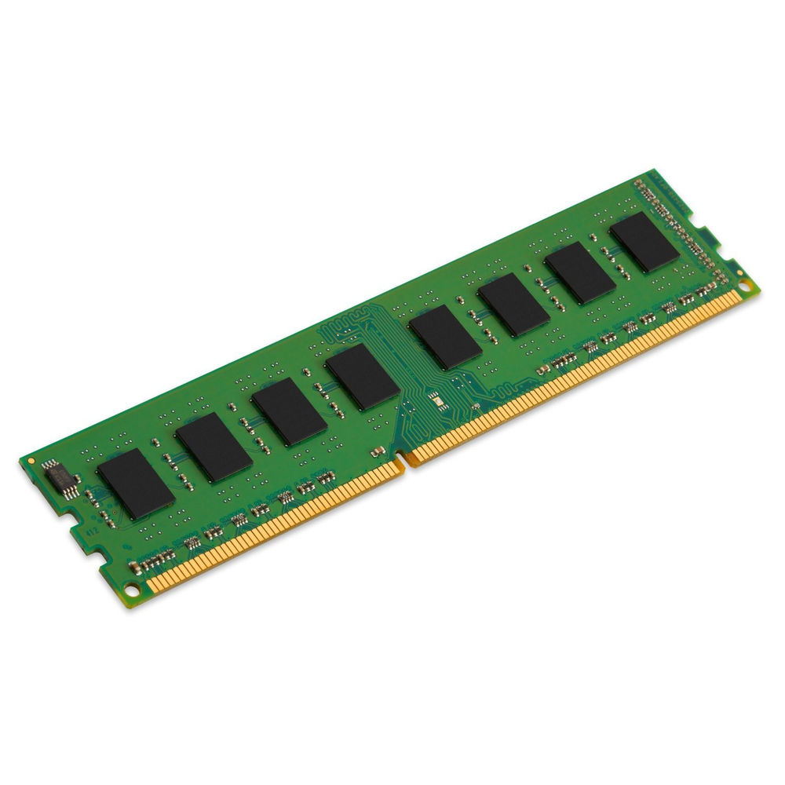
RAM
The RAM stores data and apps while being used. Without out this all our data will be gone.

Slide 8
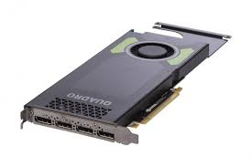
Graphics Card
The graphics card is built in the motherboard from the monitor it produces images on your onto your computer.

Slide 9
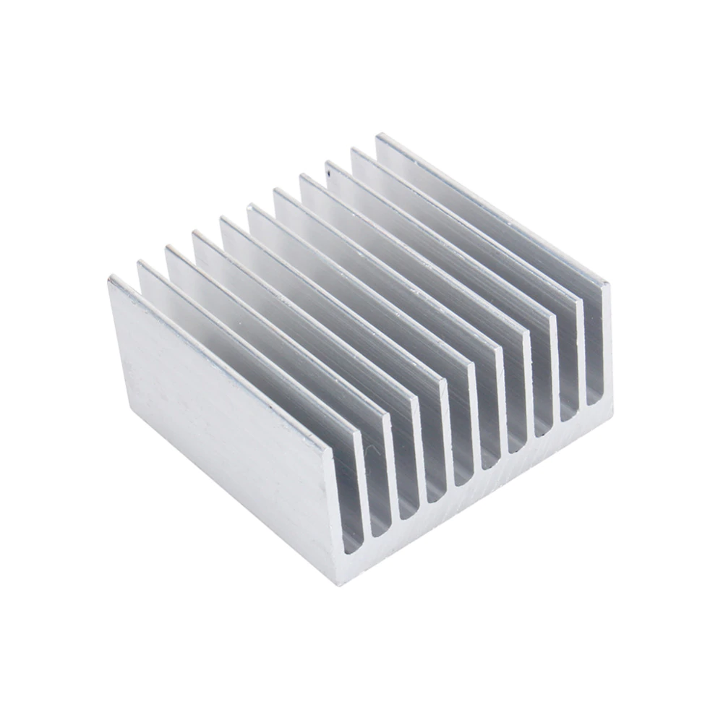
Heat Sink
A heat sink makes sure the computer is at a good temperature so if it gets too hot the heat sink will cool in down. Without this the computer would over heat then brake.

