Slide 1

SEN Information Report
September 2025

Slide 2

Contents
What is the Local Offer?
Q: Who are the key members of staff?
Q: What kind of special educational needs do we make provision for?
Q: How are special educational needs identified and assessed?
Q: What arrangements are there for involving parents?
Q: What arrangements are there for involving children with SEND?
Q: How can parents let staff know they are concerned about their child's progress?
Q: What provision is made for children with SEND?
Support for improving Social, Emotional and Mental Health of pupils with SEND

Slide 3
Contents
Q: What training is provided for staff to support pupils?
Q: How does the school evaluate the effectiveness of provision?
Q: How accessible is Westacre Middle School for children with SEND?
Q: How do we enable pupils with SEN to engage in activities?
Q: How are children prepared for transition?
Q: What can be done if parents are concerned about SEND provision?
Q: Where can parents find further information about services?

Slide 4
What is the Local Offer?
The Local Offer sets out the services available for children and young people with Special Educational Needs and Disabilities (SEND).
To view the Worcestershire County Council Local offer please click on the link below:
www.worcestershire.gov.uk/sendlocaloffer

Slide 5







Q: Who are the key members of staff?
Mrs Coldrick – SENCO
Miss Gillson-Deputy SENCO
Mrs Doolin- Inclusion Lead
Mrs Ardis –SEND support and dyslexia specialist
Mrs MacPherson – SEN Administration
Mr Williams-SEND governor

Slide 6
Q: What kind of special educational needs does Westacre Middle School make provision for?
At Westacre Middle School there are four broad areas of special educational needs which are provided for:
Communication and interaction, for example, autistic spectrum, speech and language difficulties
Cognition and learning, for example, dyslexia, dyspraxia
Social, emotional and mental health difficulties, for example, attention deficit hyperactivity disorder (ADHD), mental health
Sensory and/or physical needs, for example, visual impairments, hearing impairments, processing difficulties, epilepsy

Slide 7

Q: How are special educational needs identified and assessed?
A pupil has SEN if they have a learning difficulty or disability which calls for special educational provision to be made for them.
Special educational provision is additional to, or different from, that which is made generally for other children or young people of the same age.
Class teachers will make regular assessments of progress for all pupils and identify any concerns. This will then be discussed with the SENCO.
When deciding whether special educational provision is required, we will take into account the views and the wishes of the pupil and their parents.

Slide 8
Q: What arrangements are there for informing and involving parents of a child with SEND?
We will have an early discussion with the pupil and their parents when identifying whether they need special educational provision.
We will formally notify parents when it is decided that a pupil will receive SEN support.
Parents of all pupils are welcome to approach the school at any stage of the school year with queries relating to their child.

Slide 9
Q: What arrangements are there for informing and involving parents of a child with SEND?
Throughout the school year, there are regular opportunities (including ‘drop-in’ coffee mornings as well as targeted workshops) for parents of children with Special Educational Needs and Disabilities
For those children on SEND Support or with an EHC plan, parent and child meetings with class teachers take place termly in order to review and set IPM targets for the upcoming term. Pupils with an EHC plan have annual reviews
If external agency support is needed, parents have the opportunity to meet with or have a telephone conversation with the specialist and then discuss the report with the SEN team once it has been completed.

Slide 10
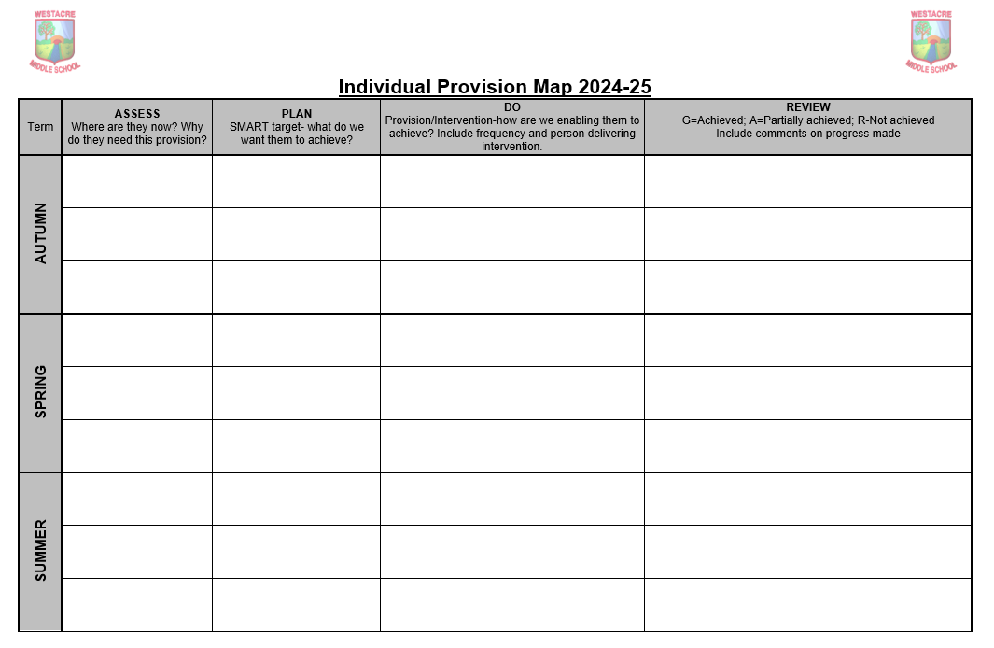

Slide 11
Q: What arrangements are there for talking to and involving a child with SEND?
Children with IPMs are invited to attend the termly meetings between parents and teachers to discuss their IPM, reviewing their progress and setting new targets.
Where outside agencies are involved, these agencies will also speak to the child to gather their viewpoint.
Pupil Voice questionnaires are carried out with children who are on the SEN register in order to gain their views.

Slide 12
Q: How can parents let staff know they are concerned about their child’s progress?
If you have concerns about your child’s progress, you should speak to your child’s class teacher initially.
If you continue to be concerned that your child is not making progress, you may speak to a member of the SEN team in school.

Slide 13

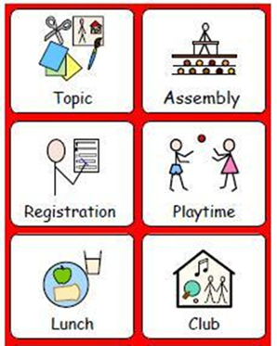
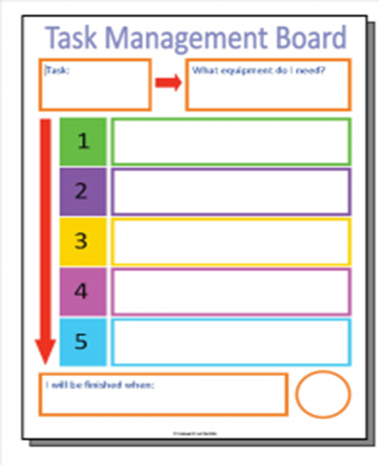
Q: What provision is made for children with SEND?
The school will adopt a graduated approach which is Assess, Plan, Do, Review.
High quality teaching is our first step in responding to pupils who have SEN
We ensure that all pupils are able to access a broad and balanced curriculum.

Slide 14
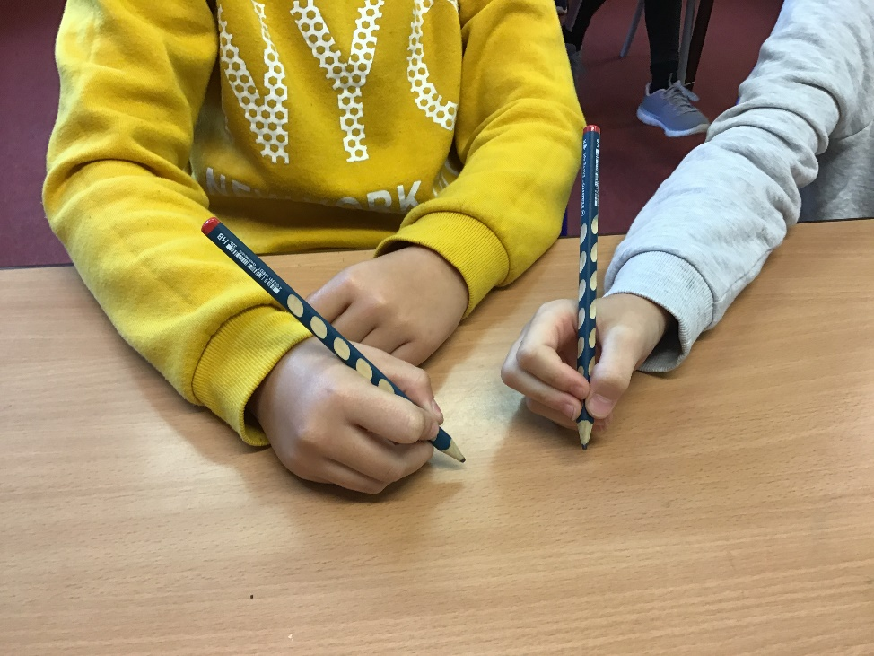
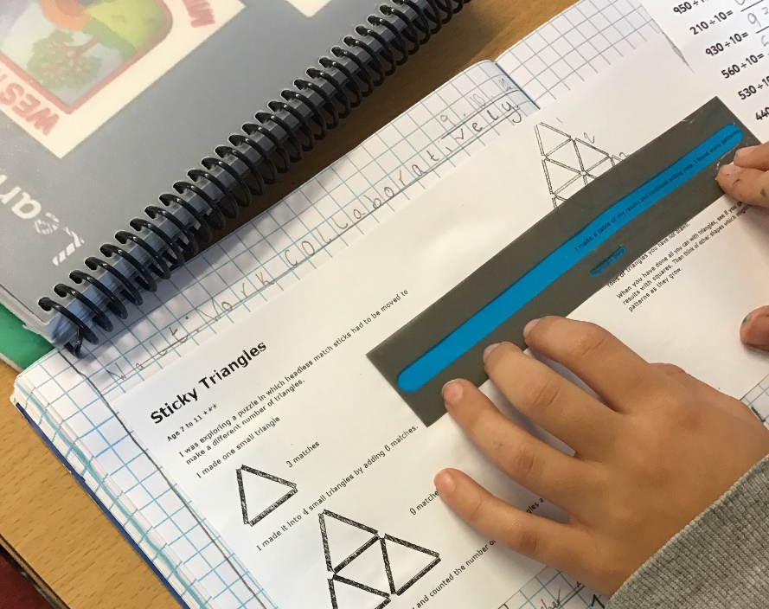
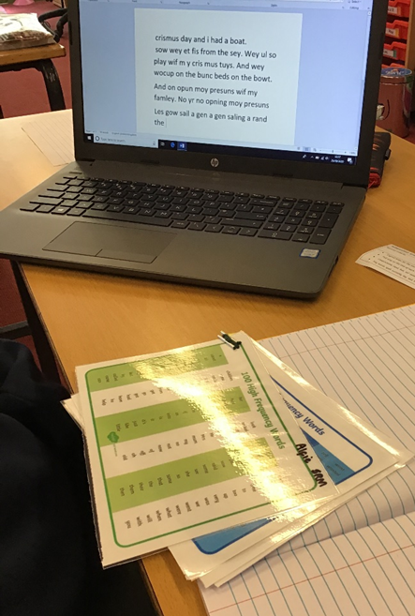
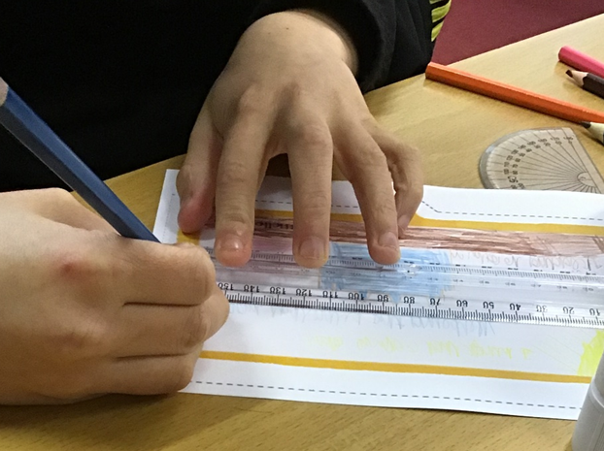
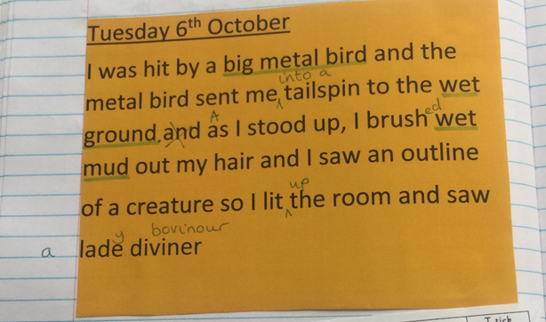

Slide 15


Q: What provision is made for children with SEND?
We will also provide the following interventions within or outside the classroom: Pre-teach, Fine and Gross Motor Skills, Speech and Language, Lightning Squad reading, NESSY spelling and Touch Typing.
Specific, individualised targets are identified and outcomes are reviewed regularly by all staff involved and shared on the pupil’s IPM. Interventions are specific and time-bound, and timetabled so that pupils receive a broad and balanced curriculum.

Slide 16


Advice from specialist outside agencies:
We currently obtain advice from:
Speech and language therapist
Learning support team
Behaviour support team
Complex Communication/ Autism team
Health- School nurse/community paediatrician
Early intervention family support
Educational psychologist
Physical Disability outreach team

Slide 17

Q: What support is available for improving the social, emotional and mental health and development of pupils with SEN?
At Westacre Middle School we recognise that the social and mental well-being of our pupils is an essential part of a successful education and the preparation for later life.
The Mental Health Lead, SENCO and pastoral team along with other members of staff are able to offer extra support to our pupils when needed.

Slide 18

Below are some examples of the support we offer:
Small group and individual interventions that help pupils to improve their self-esteem, manage emotions and support social and friendship skills.
Providing daily wellbeing sessions to promote mindfulness and positivity.
Meet and greet some pupils who feel anxious about coming to school.
Pastoral support in the mornings to help some students acquire that calm and focused attitude before lessons.
Offer ‘Catch-ups’ to those pupils who benefit from the opportunity to talk about how they are feeling.
Work alongside class teachers, parents/carers and outside agencies such as CAMHS and CAMHS WEST and our school counsellor to ensure pupils feel supported and safe.
Break and lunch pastoral support.

Slide 19
Q: What training is provided for staff to support pupils?
Ongoing updates and new training takes place for all staff regularly. This includes Whole School SEND, Inclusive classrooms, Dyslexia, Autism, Anxiety and Attachment training.
Our SENCO has completed the National Award in Special Educational Needs Co-ordination.
Our dyslexia advocate teacher has completed additional training in supporting pupils with dyslexia.
We also have Communication Trained Teaching Assistants who run interventions.

Slide 20
Q: How does the school evaluate the effectiveness of provision for pupils and assess / review their progress?
We evaluate the effectiveness of provision for pupils with SEN by:
Reviewing pupils’ individual progress towards their IPM targets each term
Reviewing the impact of interventions
Using pupil voice questionnaires
Monitoring by the SENCO
Holding annual reviews for pupils with EHC plans
Learning walks

Slide 21

Q: How accessible is Westacre Middle School for children with SEND?
The school is on a split-level therefore the needs of individual pupils are considered when placing children in specific classrooms. There is a bathroom management area. We ensure where ever possible that equipment used is accessible to all children regardless of their needs.

Slide 22

Q: How do we enable pupils with SEN to engage in activities with other pupils who do not have SEN?
All of our extra-curricular activities and school visits are available to all our pupils, including our before-and after-school clubs.
We work with parents and pupils to listen to their views, feelings and wishes to ensure pupils with SEN engage fully in the life of the school and in any wider community activity.

Slide 23

Q: How are children prepared for transition to other schools?
We recognize that transitions can be difficult for a child with SEN, and we take steps to ensure that any transition is as smooth as possible.

Slide 24
If your child is joining us in Year 5:
The Year 5 Leader, SENCo and Pastoral Lead visit First Schools in the Summer term prior to entry. Meetings are held between First school and Westacre Middle School staff to transfer all relevant information. Every child will attend a transition day at Westacre Middle School in July. Additional visits will be arranged as necessary in order to cater for specific individual needs.

Slide 25
Transfer to High School:
Children leaving Westacre Middle School at the end of Year 7 to attend Droitwich Spa High School will be part of the Droitwich Pyramid School’s transition programme. If a child transfers to a school outside of the pyramid, all information will also be passed on. Additional visits will be arranged as necessary in order to cater for specific individual needs.

Slide 26
Q: What can be done if parents are concerned about the school’s provision for pupils with SEND?
In the first instance we encourage you to contact your child’s class teacher. If you still have concerns then please contact the SENCo, then the Headteacher. In the unlikely event that your concern is not resolved then please contact our Chair of Governors.

Slide 27

Q: Where can parents find further information about services to support them or their child?
SENDIASS Worcestershire is available to support parents of SEN pupils.
Welcome to SENDIASS Herefordshire and Worcestershire | Worcestershire County Council
Parents are also able to contact the Early Intervention Family Support Service through a referral system.

