Slide 1

Special Educational Needs provision at Westacre Middle School

Slide 2
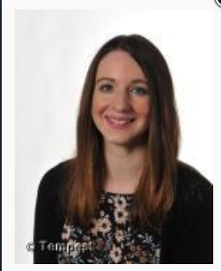
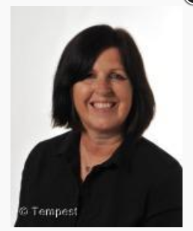
Meet Our Team
Miss Brighton
SENCo
Mrs MacPherson
SEN Admin Manager
Teaching Assistant

Slide 3
Our SEN Register
SEN Support
A child or young person has special educational needs if he or she has a learning difficulty or disability which calls for special educational provision to be made for him or her.
A child has a learning difficulty or disability if he or she has significantly greater difficulty in learning than the majority of others of the same age or has a disability which prevents or hinders them from making using of the facilities in a mainstream school.
SEN provision is that which is additional to or different from that made generally for others of the same age in mainstream schools. The use of outside agencies very much depends upon the individual needs.
Education, Health and Care Plan
An education, health and care (EHC) plan is for children and young people aged up to 25 who need more support than is available through SEN Support. They identify educational, health and social needs and set out the additional support to meet those needs.

Slide 4
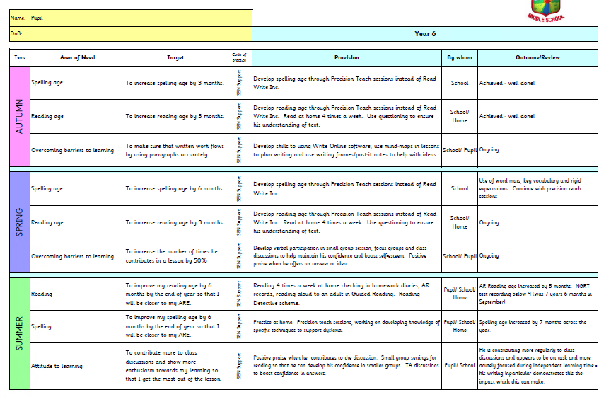
Individual Provision Maps

Slide 5
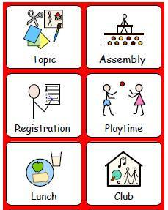




Inclusive Classrooms

Slide 6

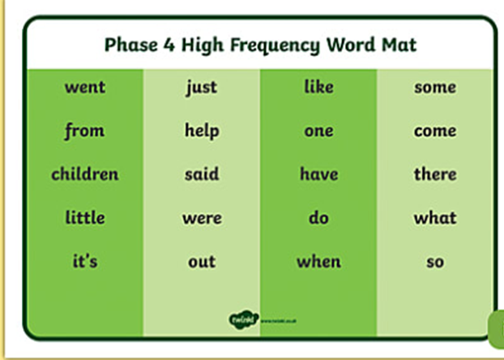
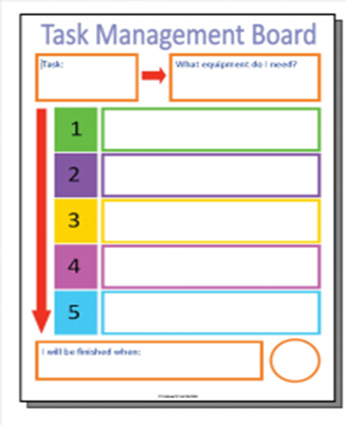
Inclusive Classrooms

Slide 7






ICT in the Classroom

Slide 8




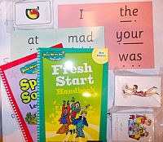


Improving Reading
Reading detectives

Slide 9
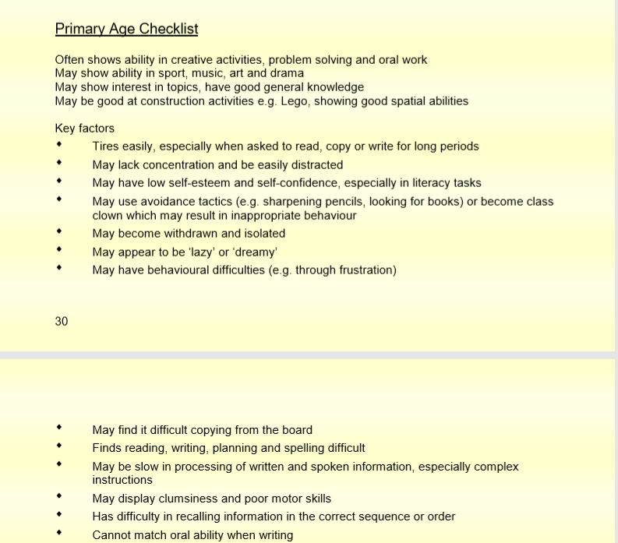
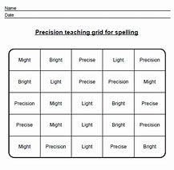

Improving Spelling

Slide 10



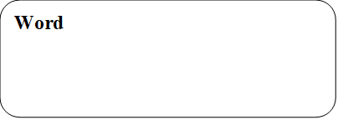
Speech and Language Interventions
Pre-teach

Slide 11


Cognition and Learning Interventions
Pre-teach

Slide 12



Sensory and Physical Interventions

Slide 13




Social, Emotional and Mental Health Interventions

Slide 14



Social and Emotional Mental Health

Slide 15





Pastoral Support

Slide 16




