Slide 1

Welcome to
Inspire. Challenge. Achieve.

Slide 2
Your child belongs to
5DC
Inspire. Challenge. Achieve.

Slide 3

Inspire. Challenge. Achieve.

Slide 4

Inspire. Challenge. Achieve.

Slide 5
So far…….
Year Leader has visited all of the
first schools to meet the children
and their current teachers.
One of our current year 5 teachers showed your children a PowerPoint and
answered their questions.
Inspire. Challenge. Achieve.

Slide 6
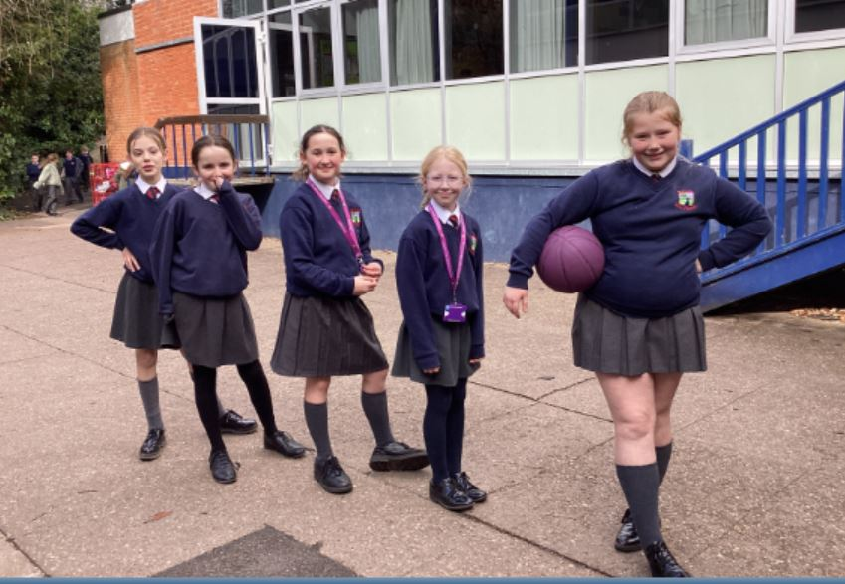
Thursday 3rd September
Children go to Y5 Playground
We are in our classrooms at 8:25am
Parents to drop their child off at the front
or back gate.
Inspire. Challenge. Achieve.

Slide 7
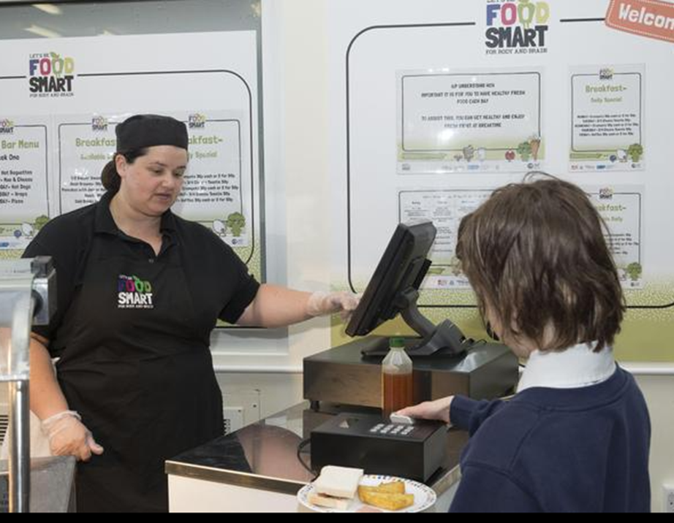
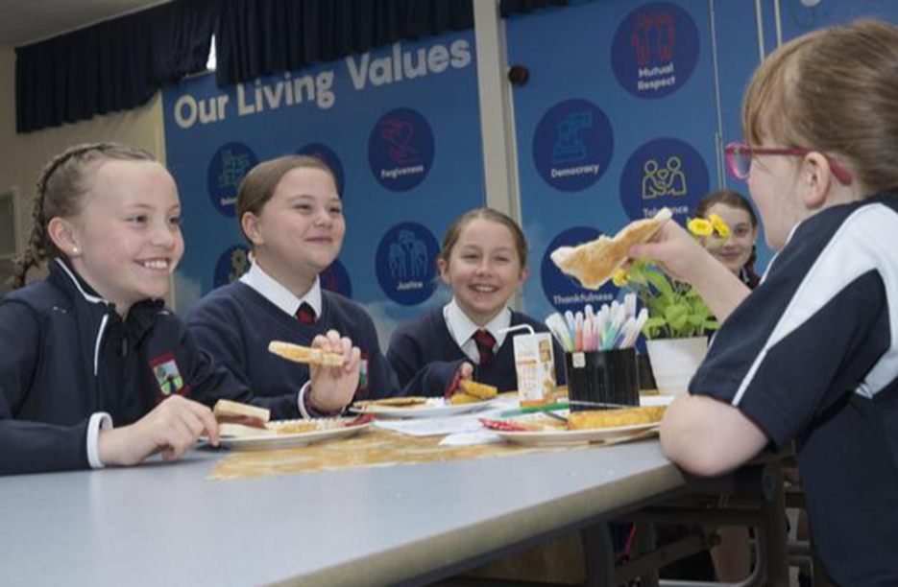
Current lunch cost is £2.61
(This is subject to change for September).
Water is free, other drinks cost 90p –£1.10
Children need a pre-loaded Arbor account to purchase hot meals.
Inspire. Challenge. Achieve.

Slide 8
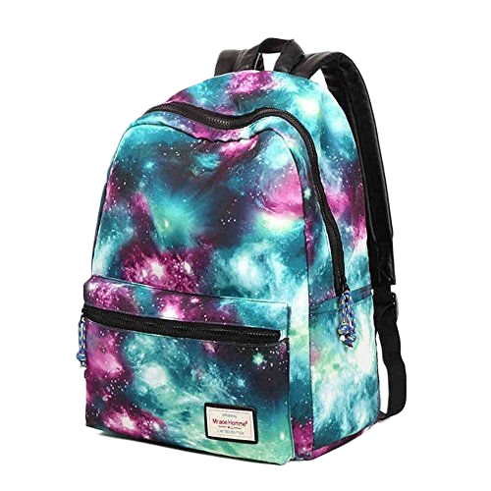
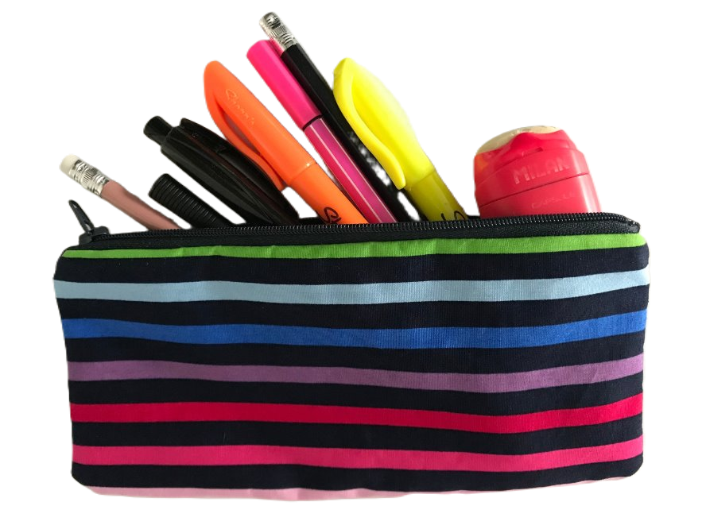


School Bag
Reading book
Learning Journal
Pencil Case
Water Bottle
Inspire. Challenge. Achieve.

Slide 9
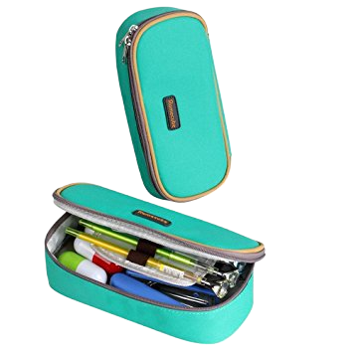
Pencil Case
Blue handwriting pen (not biro)
Pencil
Glue Sticks
Red Pen
Pencil crayons
Rubber
Sharpener
Highlighter
Ruler
Inspire. Challenge. Achieve.

Slide 10
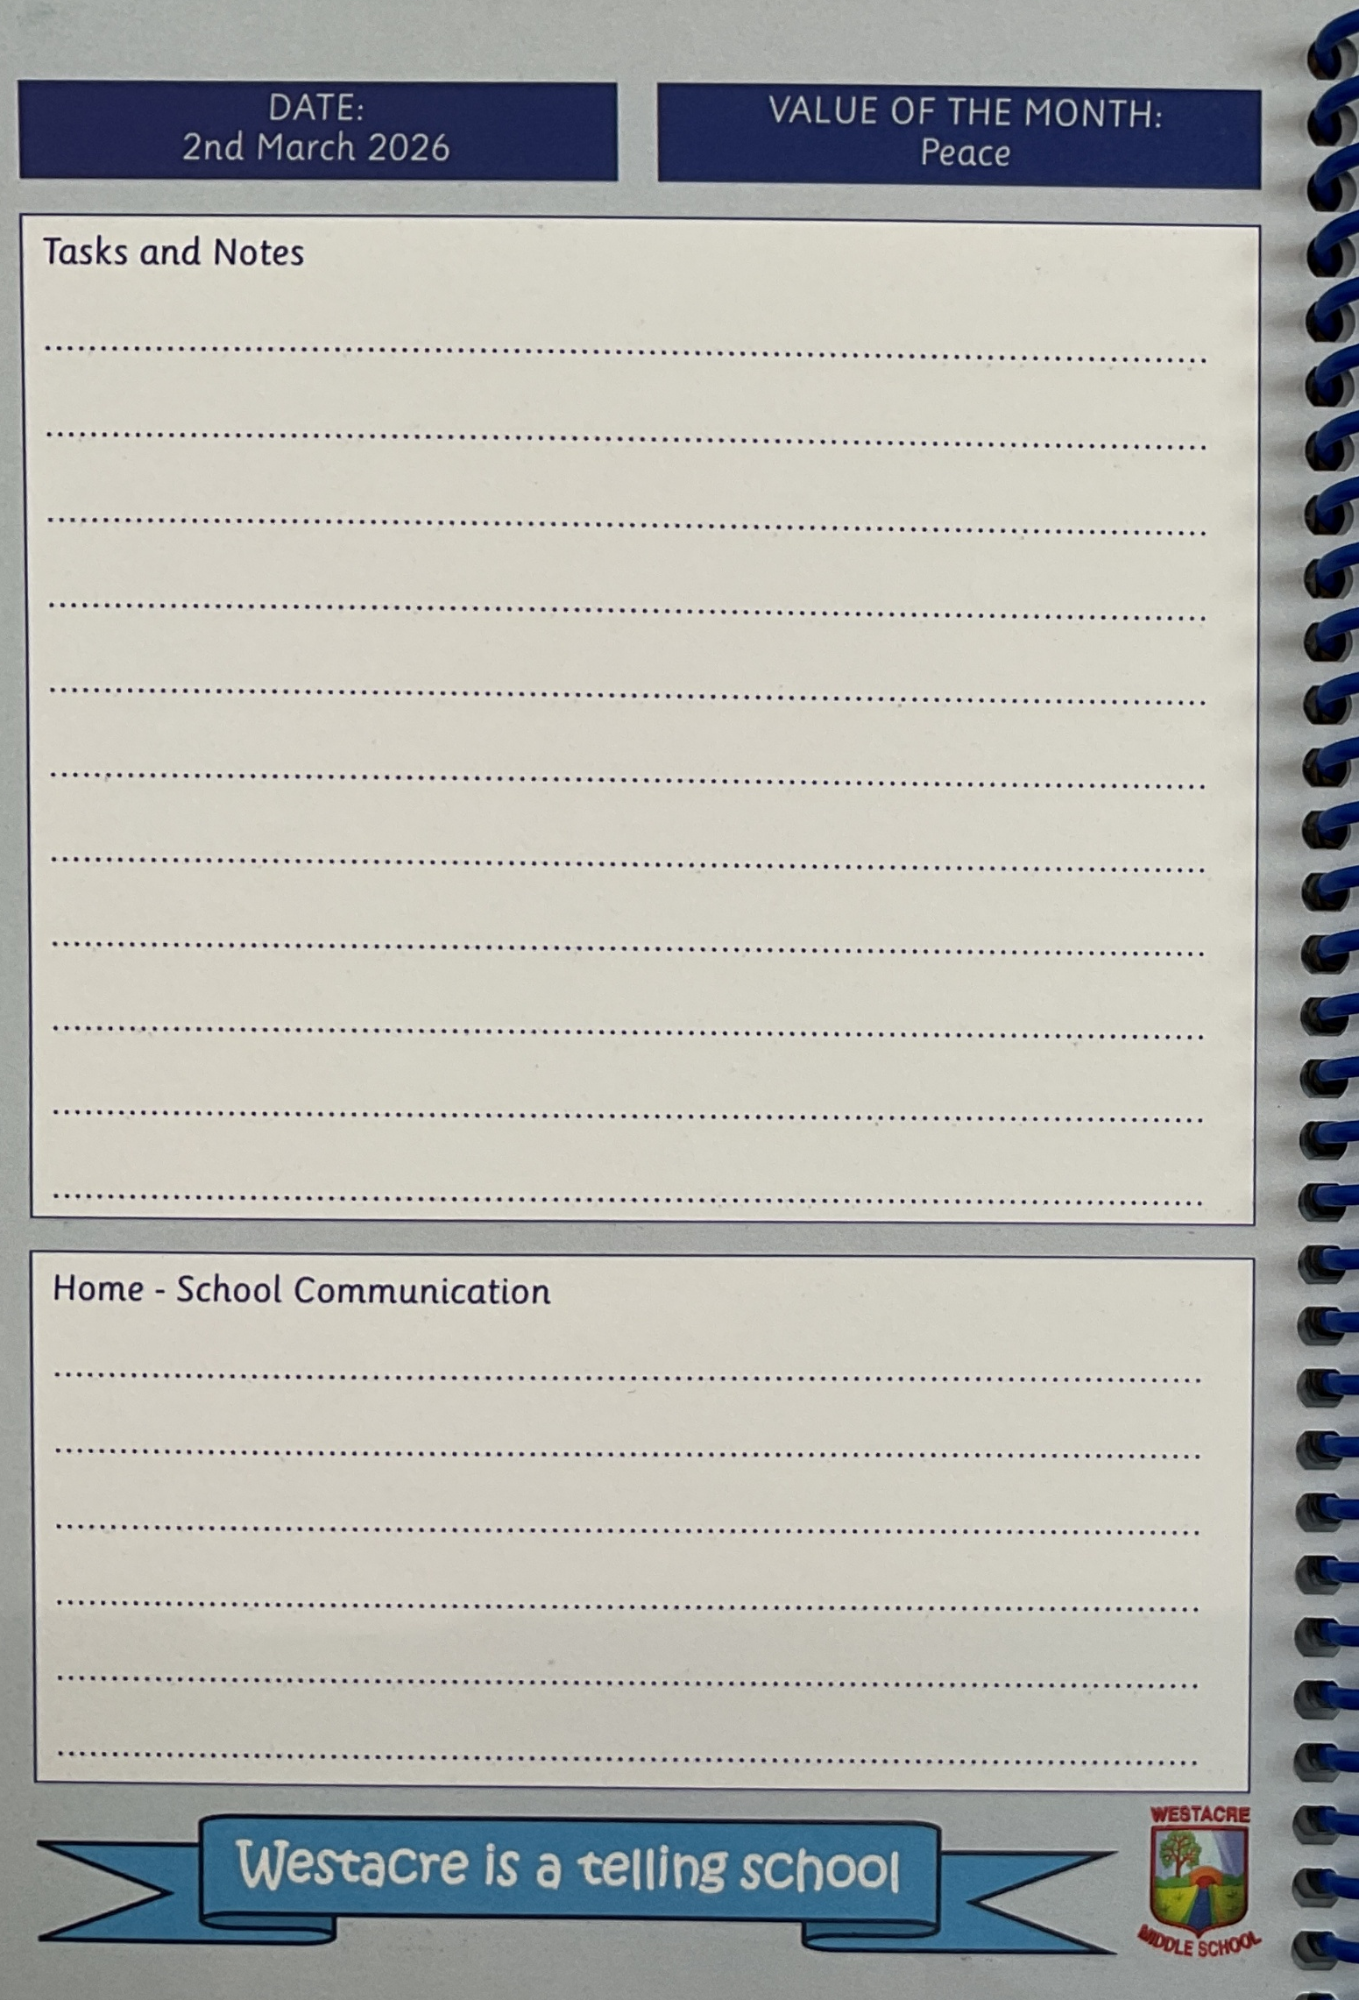
Learning Journal
Key Communication between home and school & timetable
Westacre Middle School website
New Year 5 Intake September 2026 | Westacre Middle School
Inspire. Challenge. Achieve.

Slide 11



HOMEWORK
Reading - we recommend 4 times a week, which should be recorded in Learning Journal
Online Maths Practice (including Century Tech or Times Table Rock Stars)
Spellings will be given
Topic-based project homework
Inspire. Challenge. Achieve.

Slide 12
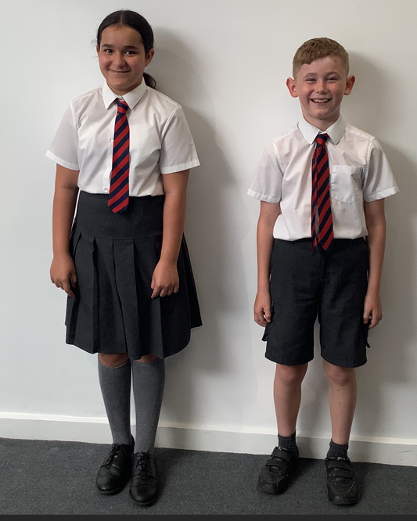
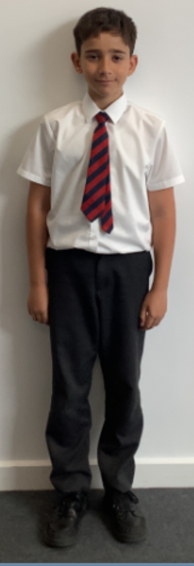
At Westacre we have high standards of uniform.
White, collared shirt.
Top button done up.
Westacre tie
Grey knee length/
just below
the knee skirt
(no leggings or tight
Fitting trousers)
Formal grey
shorts/trousers
Grey school socks/
tights
Grey school socks
Black, formal school
shoes
(no trainers)

Slide 13
School Uniform
(this information, and how to order, has been emailed to parents)
Compulsory Uniform
· Navy V-Neck jumper with school logo
· White shirt with top button
· Navy and red striped tie
· Formal grey/charcoal grey trousers or skirt (knee length) *
· Black, formal shoes (no heels/no boots/no canvas shoes or trainers)
· Grey/Navy socks/tights
Optional Uniform
· Formal grey/charcoal grey shorts *
· Coat (no sweatshirts, zipped or hooded tops)
Parents will be contacted if pupils do not meet our high standards of uniform. ​

Slide 14
School Uniform
Children who have their ears pierced may wear up to one plain stud in each ear on the lobe, not on the top of the ear, other than a watch, children are not allowed to wear bracelets, rings or any other items of jewellery in school.
Inappropriate hairstyles are not allowed in school, this includes hair with shaved patterns/ lines/ tracks, ‘skinheads’/fades. Furthermore, overly coloured or bleached hair will not be accepted.
Hair accessories should be plain and small hair slides are acceptable. No large hair accessories are permitted.
Make up and nail varnish is not permitted, and children will be asked to remove it.
Parents will be contacted if pupils do not meet our high standards of uniform. ​

Slide 15



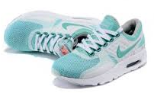
Please ensure all school clothes & P.E. kit are named
Children should wear smart school P.E.kit to school on the day they have P.E.
Pupils will need to bring their kit to school to change into if they have an after-school Sports Club.
Inspire. Challenge. Achieve.

Slide 16
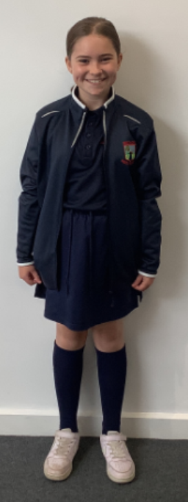
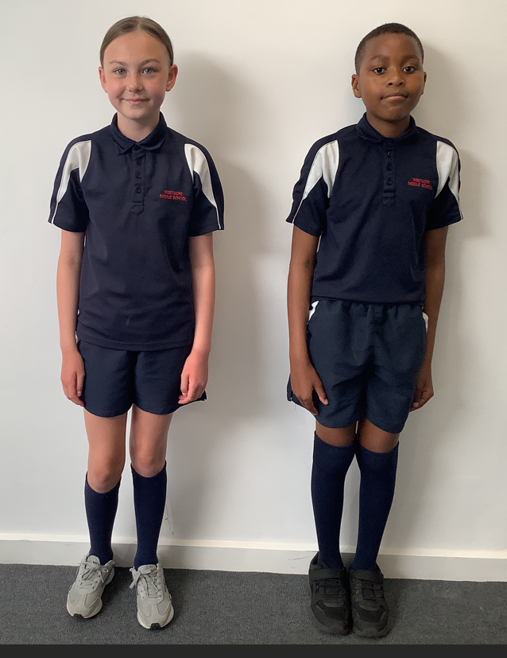
At Westacre we have high standards of P.E. kit.
Long hair tied back
Westacre polo shirt
Westacre jacket
Westacre skorts
Westacre shorts
Long, navy P.E. socks
Suitable sports
trainers

Slide 17
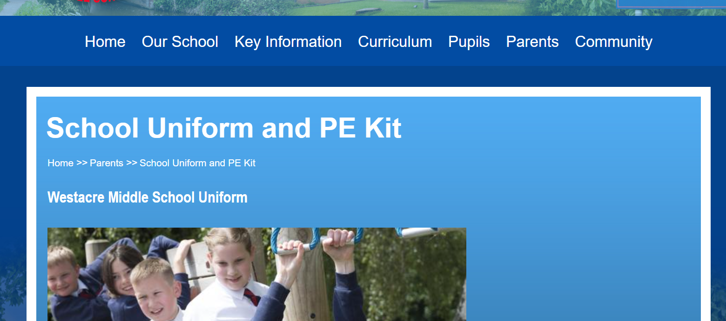
Check the website for how to purchase uniform
Inspire. Challenge. Achieve.

Slide 18
For School Clubs
Lunchtime & After School...
See Parent App & School Website for signing up
School Office for Drum/Guitar/Piano tuition
Inspire. Challenge. Achieve.

Slide 19


School Website
Great for information and a good chance to learn about your child’s
day and experiences
Inspire. Challenge. Achieve.

Slide 20

This is our primary method of communication.
By now you will have received an email with instructions of how to log in and set up your account.
Please contact the school office if you need any support with this.
Inspire. Challenge. Achieve.

Slide 21
Entering School
Main Gate
or
Back Gate (year 6/7 playground)
Please make sure children know where to meet you at end of the day!
Especially on Thursday 3rd September
Inspire. Challenge. Achieve.

Slide 22
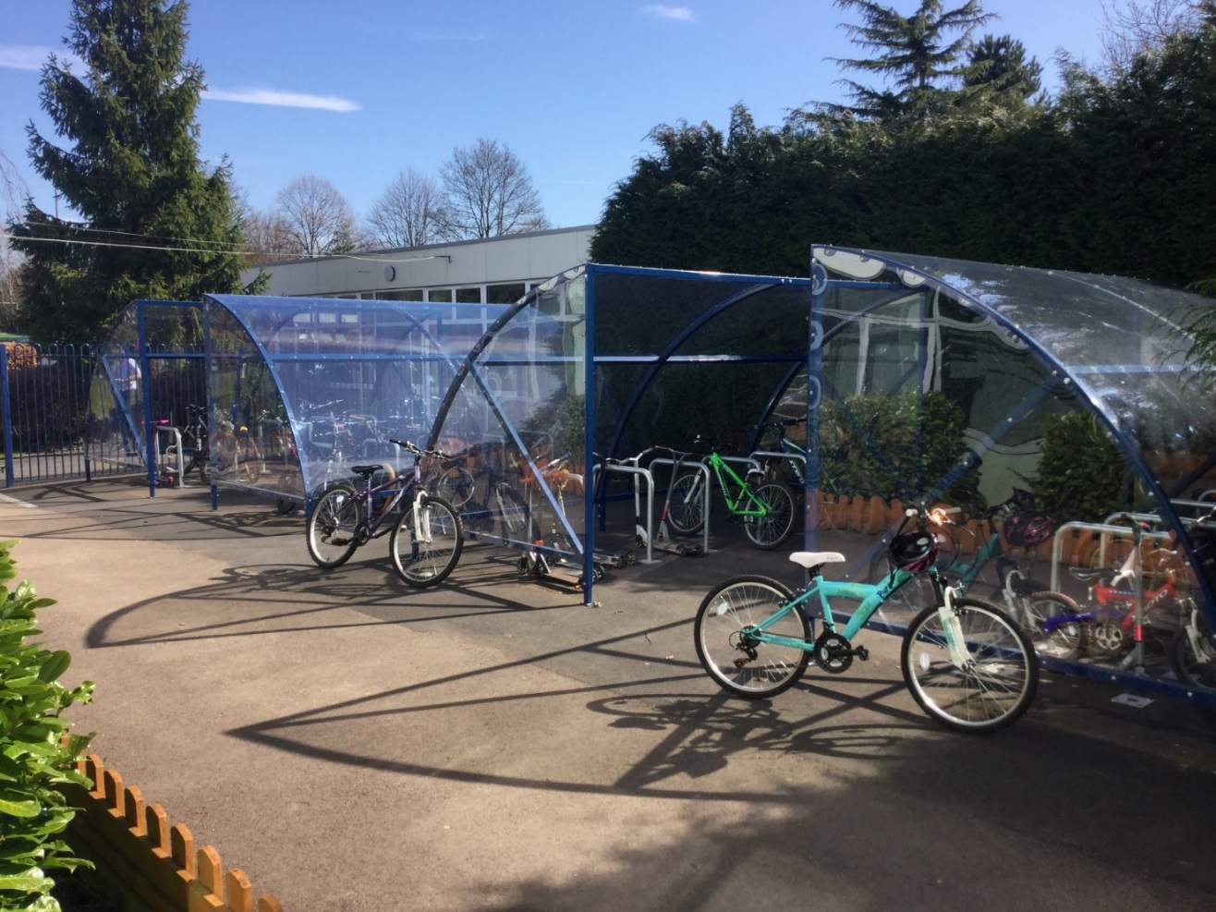

Scooters and Bikes
Must wear a helmet and bring a padlock
Inspire. Challenge. Achieve.

Slide 23



Breakfast Club
Warm welcome to the day!
Our Breakfast Club is really popular.
There is no need to sign up in advance.
Breakfast Club
7.45am until 8:15am
Monday to Friday
No Charge:
Toast
Cereal
Fruit
Water
Charged items:
Juice
Bacon/sausage baps
Croissants
Pancakes etc.
Inspire. Challenge. Achieve.

Slide 24

This is the current menu and may be updated for September.
Inspire. Challenge. Achieve.

Slide 25
Valuables, Money, Phones
Child’s own responsibility.
No phone to be seen in school!
Switched off & put in bag before entering school premises.
Not to be looked at or switched on again until after children have left school gates.
Please see mobile phone policy on website.
We strongly discourage the setting up/use of class group
chats on social media.
Inspire. Challenge. Achieve.

Slide 26
Breaktime Snacks
Fruit or plain biscuits only
Named water bottle is essential
Inspire. Challenge. Achieve.

Slide 27



Medications
Every child who has medication or specific
health or medical needs
MUST have a health care plan.
These are available tonight for you to complete.
Inspire. Challenge. Achieve.

Slide 28
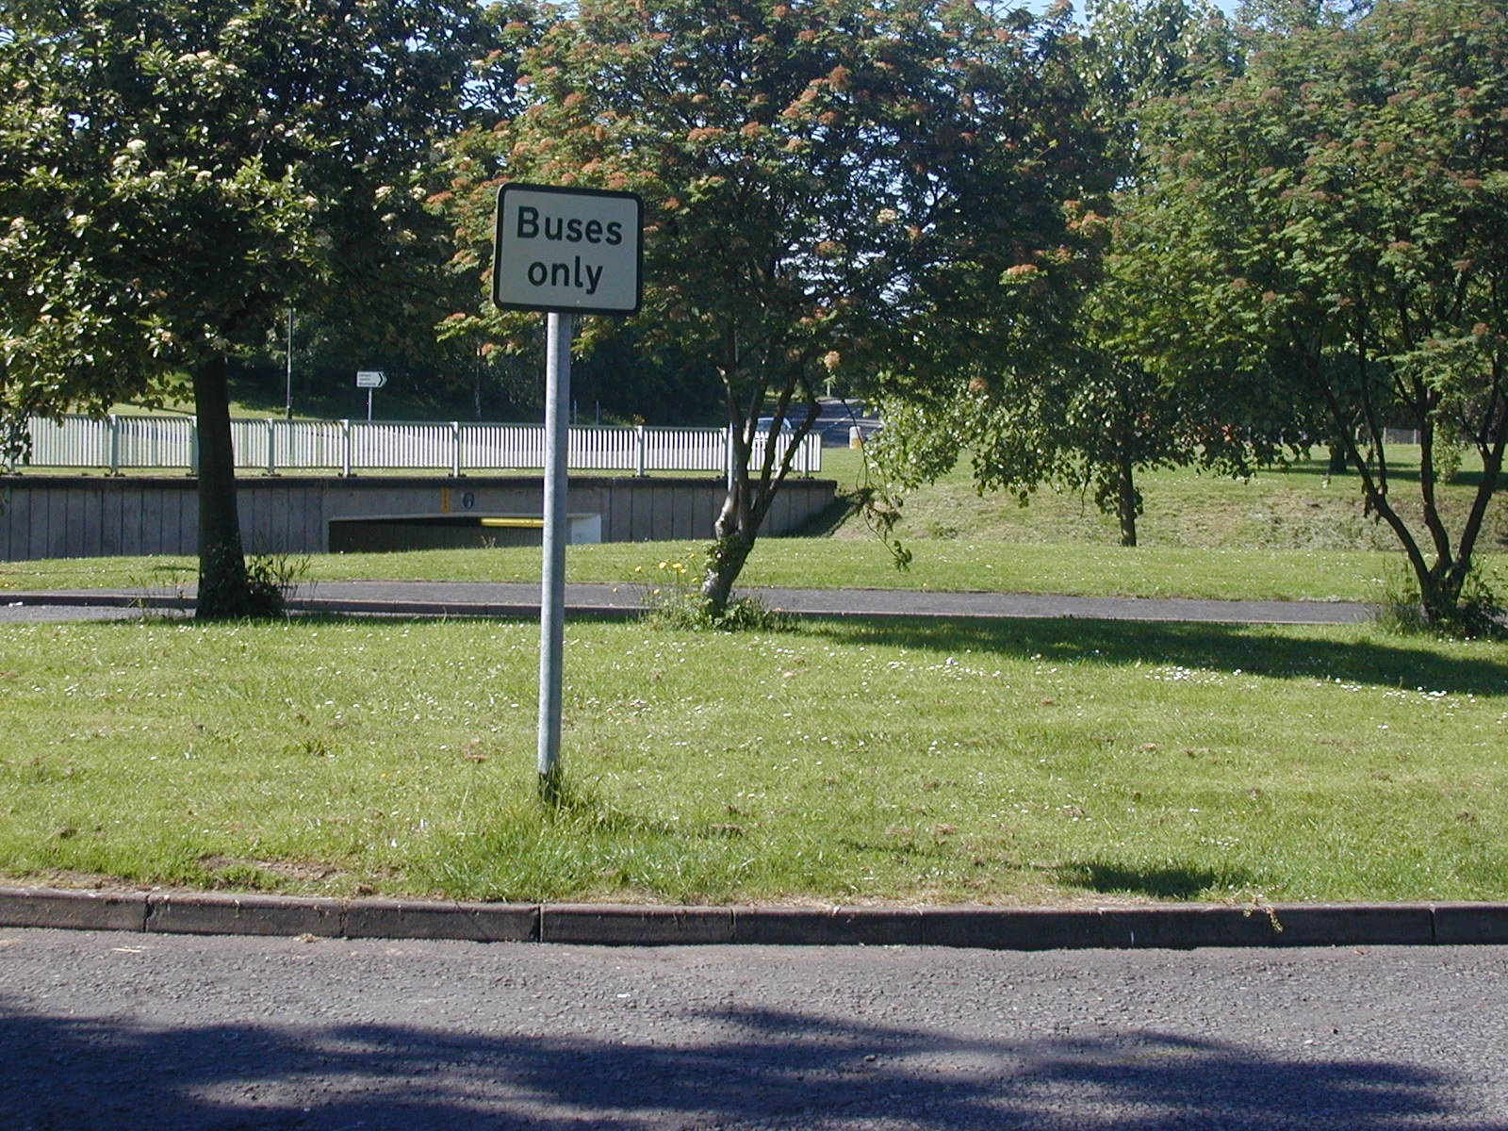
Bus Children
Excellent behaviour expected
Children taken to bus for first few days
County Council have overall responsibility
Inspire. Challenge. Achieve.

Slide 29
Work Alongside Sessions
We invite parents to join their children
in their lessons during the Autumn Term
Watch this space!
You can experience our Westacre learning
environment to help you to support your child.
Inspire. Challenge. Achieve.

Slide 30
We look forward to seeing you and your children on
Thursday 3rd September
Inspire. Challenge. Achieve.

