Slide 1

Welcome to Year 6
Inspire. Challenge. Achieve.

Slide 2
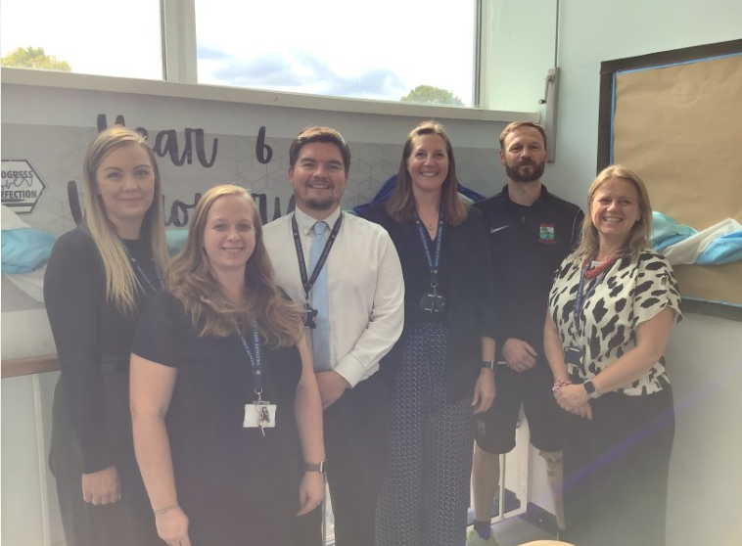
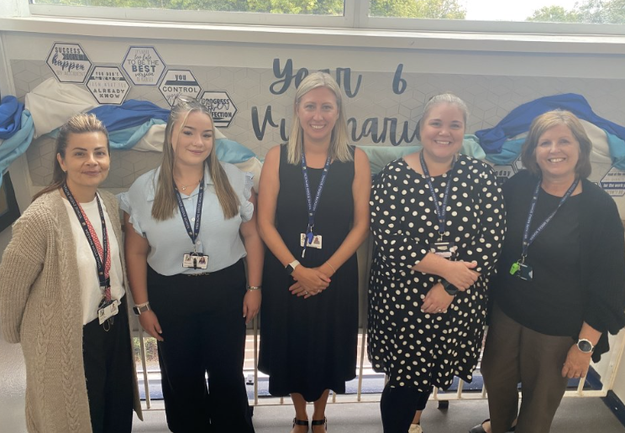
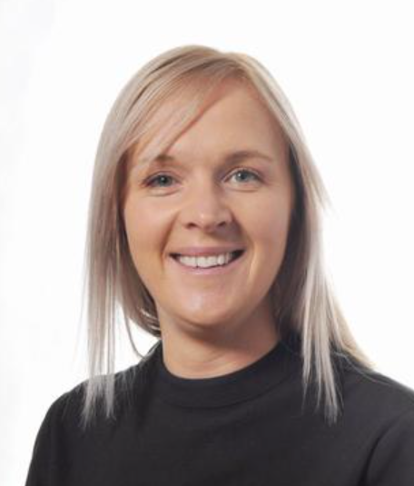
Mrs West – Head of Year & Class Teacher
Mrs Adey - 6RA
Mr McMullen – 6LM
Mr Treadwell - 6JT
Mrs Murray and Miss Gillson - 6MG
Mrs Bennett and Mrs West - 6WB
We are ably supported by many other teaching staff and teaching assistants
Meet the Year 6 Team

Slide 3
Expectations: Building on from Year 5
Punctuality and attendance
Uniform
PE Kit (days on the next slide)
Participation in all aspects of school life
Being prepared and organised
Independence – 6Rs
Homework
Inspire. Challenge. Achieve.

Slide 4
What's different in Year 6?
•Extending learning from year 5
•SATS
•Preparing the children for the KS3 curriculum ‘being high-school ready’

Slide 5
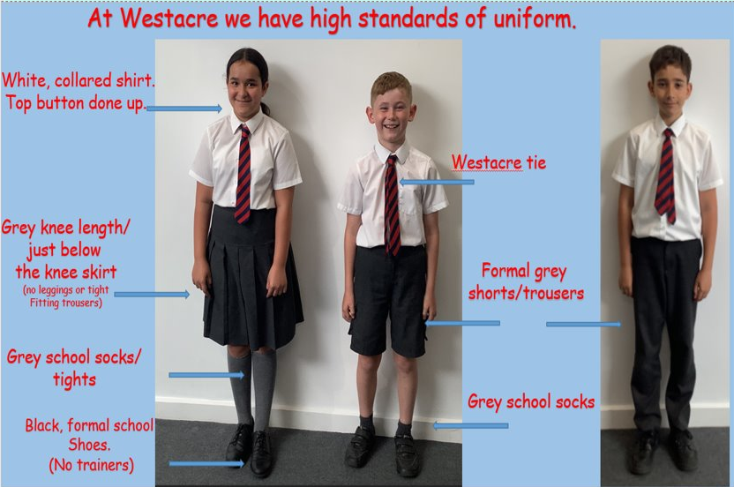
School Uniform

Slide 6
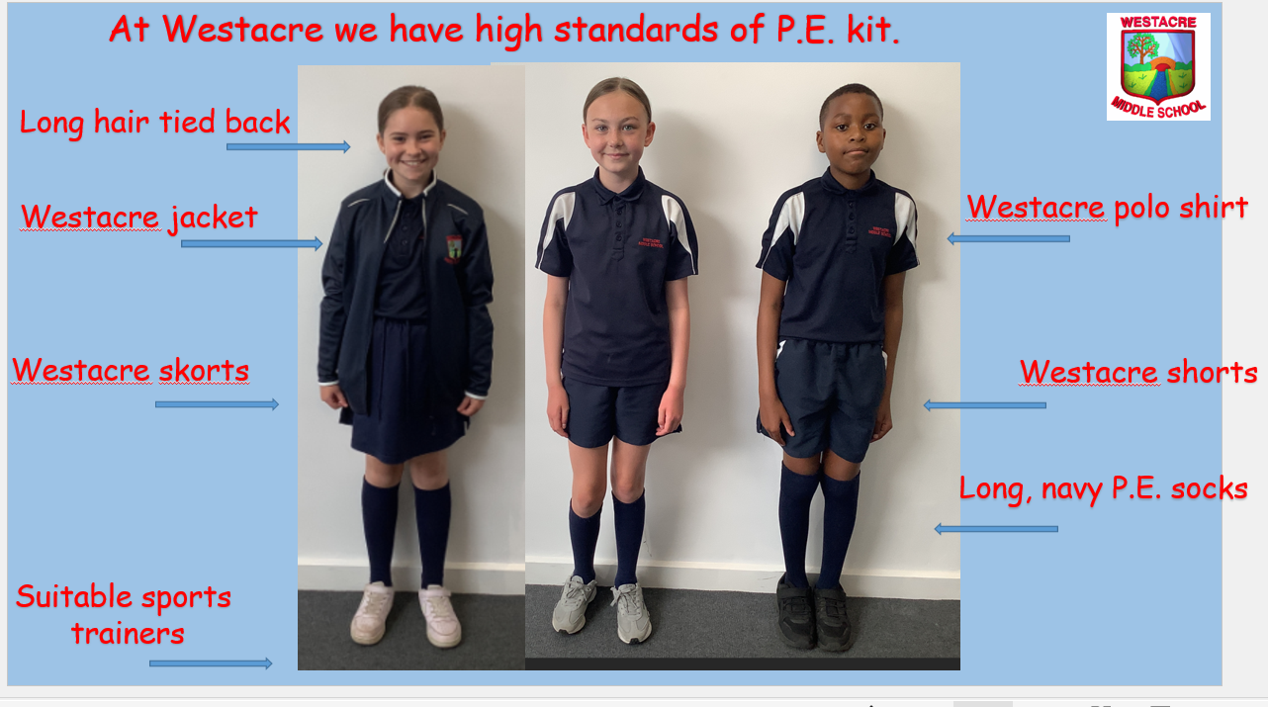
PE Kit
Tuesday | Wednesday | Thursday | Friday
6RA | 6WB | 6JT & 6MG | 6LM

Slide 7
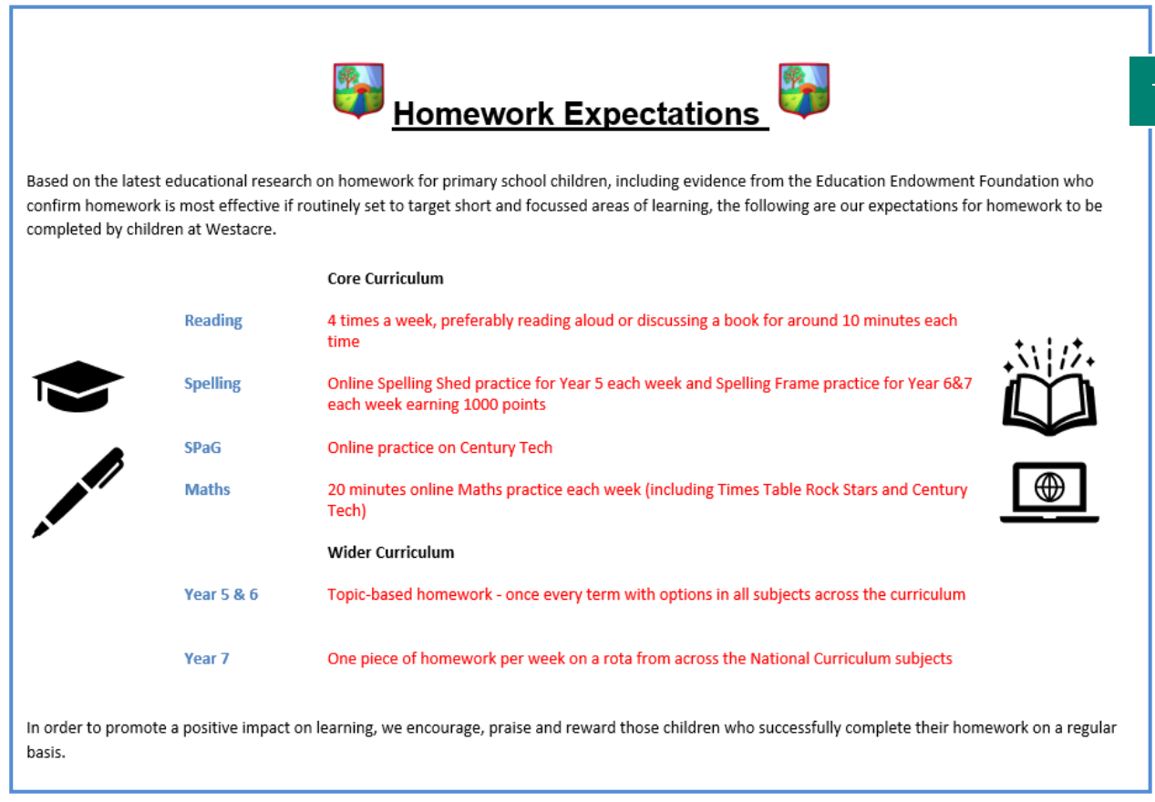
Homework

Slide 8
SATs
The KS2 SATs are scheduled for Monday 11th May to Thursday 14th May.
Monday
English grammar, punctuation and spelling Paper 1: questions
English grammar, punctuation and spelling Paper 2: spelling
Tuesday
English reading
Wednesday
Mathematics Paper 1: arithmetic
Mathematics Paper 2: reasoning
Thursday
Mathematics Paper 3: reasoning
Meeting in January
Calm Approach
'Try Their Best'

Slide 9

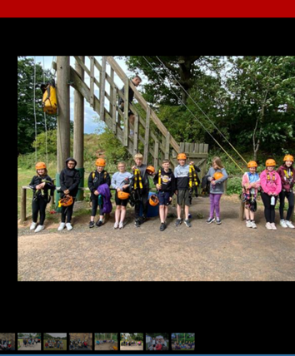
Year 6 Blackwell
Residential
Monday 13th July – Wednesday 15th July
Initial interest meeting will be held on Wednesday 24th September.

Slide 10
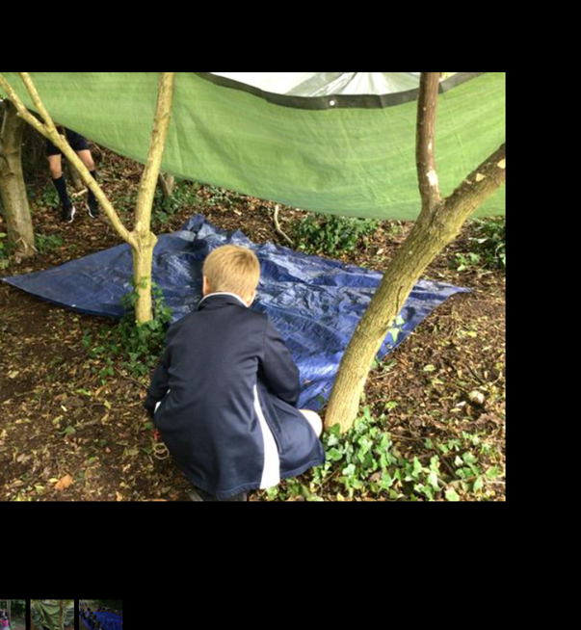
Year 6 Survival Week
Map making
Orienteering
Using tents (setting up and dismantling)
Forest school
Craft activities
Physical activities and experiments

Slide 11

This term’s CC topic is… Ancient Greece
Developing a variety of skills…
-Curriculum Jigsaw
-World Geography
-Significant events in Ancient Greek History
-Developing our cooking skills by making a Greek dish
-Developing our 3D art skills by making a Greek Vase out of clay
-CC Homework
Inspire. Challenge. Achieve.

Slide 12

CC homework
Inspire. Challenge. Achieve.

Slide 13


Recognition
Inspire. Challenge. Achieve.

Slide 14

Catering
Breakfast club from 7:45am
Otherwise, come onto the playground from 8:15 – 8:25
Selection of items available which are free of charge (cereal, toast)
Lunches cost £2.58 (cashless)
Drinks are additional cost (water free of charge)
Inspire. Challenge. Achieve.

Slide 15
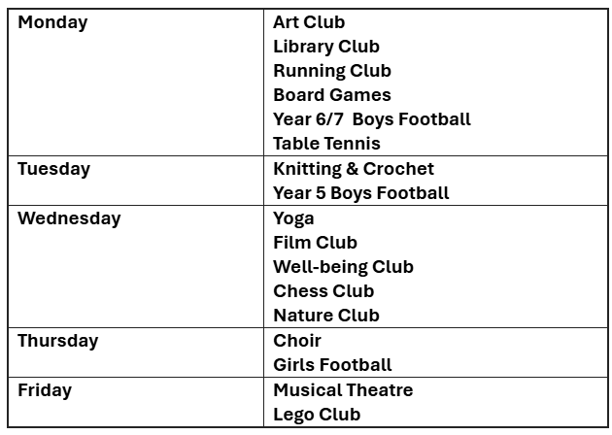
After School Clubs
Inspire. Challenge. Achieve.

Slide 16
After School Clubs
Sign up from 9th September 12:00pm until Thursday 11th 12:00pm
Children will be selected at random for a place
Parents/carers will be notified by Arbor if their child has secured a place at the club by the end of the school day on Thursday
Clubs commence from next Monday (15th September)
Any questions, please contact the school office (01905 772795 or office@westacre.worcs.sch.uk
Inspire. Challenge. Achieve.

Slide 17




Communication
Inspire. Challenge. Achieve.

Slide 18
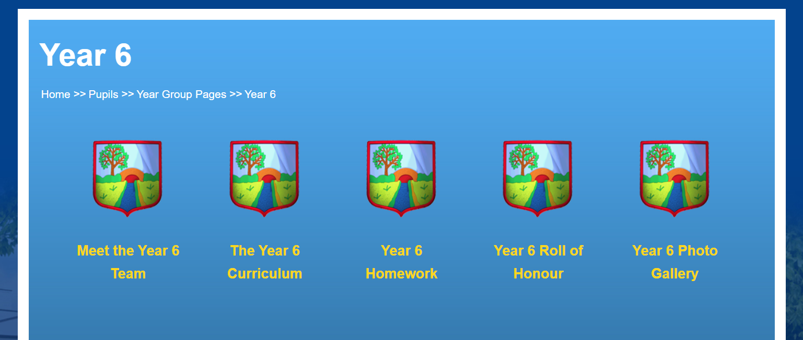
Year 6 Website

Slide 19
Key Dates
12th September - School Photographs
22nd September - Year 6 / 7 Homework Workshop 1.45pm - 2.45pm
24th September - Year 6 Blackwell residential initial interest meeting 6.00pm-7.00pm
2nd October – Open Day and Evening
5th & 12th November - Pupil Learning Discussions - online 4.00pm- 7.00pm (more information to follow)
8th and 9th December – Cathedral Trip
19th December – whole school theatre trip
Inspire. Challenge. Achieve.

Slide 20
Visiting the class
Reader’s Theatre
A widely used teaching strategy that exemplifies how repeated reading of texts can be used to support pupils to develop reading fluency
Inspire. Challenge. Achieve.

