Slide 1

Welcome to Year 5
Inspire. Challenge. Achieve.

Slide 2
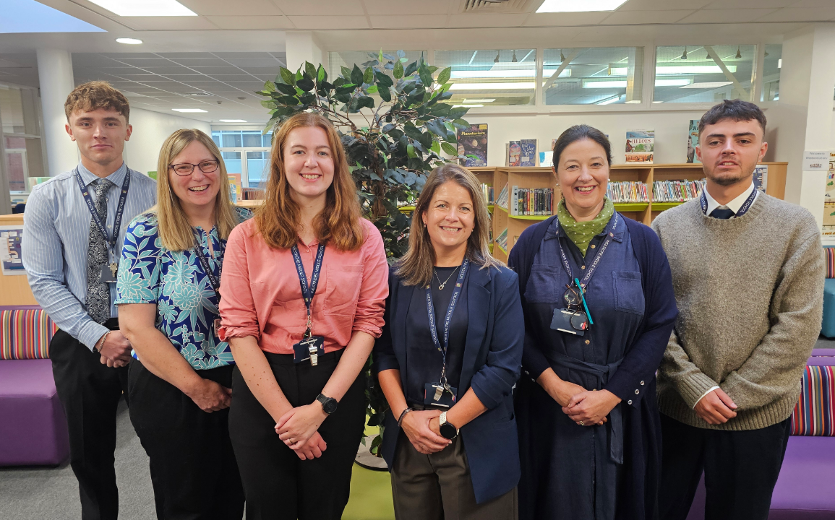
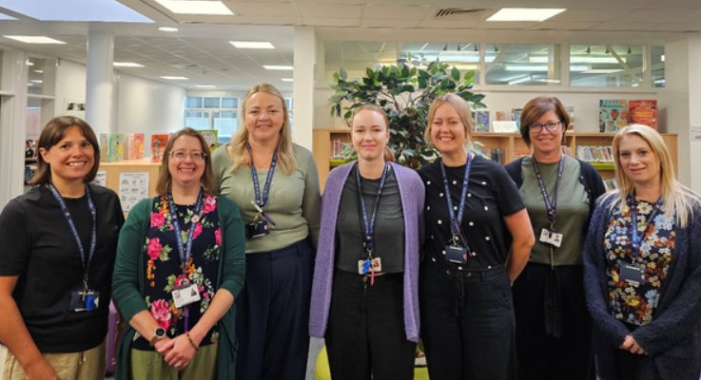
Mrs Humphries – Head of Year & Assistant Head
Mrs Holden - 5TH
Mr Cartwright - 5DC
Mrs Truman - 5LT
Mrs Riddleston - 5JR
Mr Street - 5TS
We are ably supported by many other teaching staff and teaching assistants
Meet the Year 5 Team

Slide 3
Expectations: Building on from First School
Punctuality and attendance
Uniform
PE Kit (days on the next slide)
Participation in all aspects of school life
Being prepared and organised
Independence – 6Rs
Homework
Inspire. Challenge. Achieve.

Slide 4
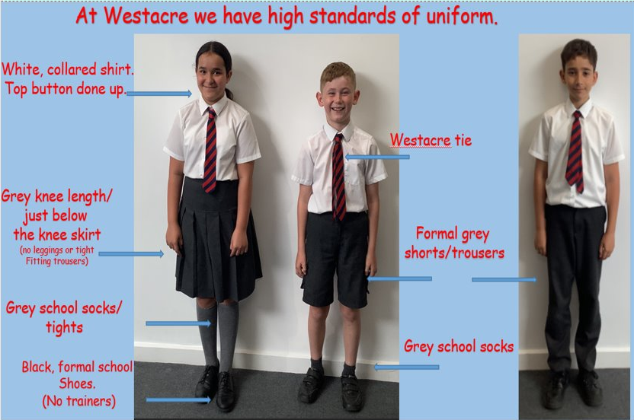
School Uniform

Slide 5
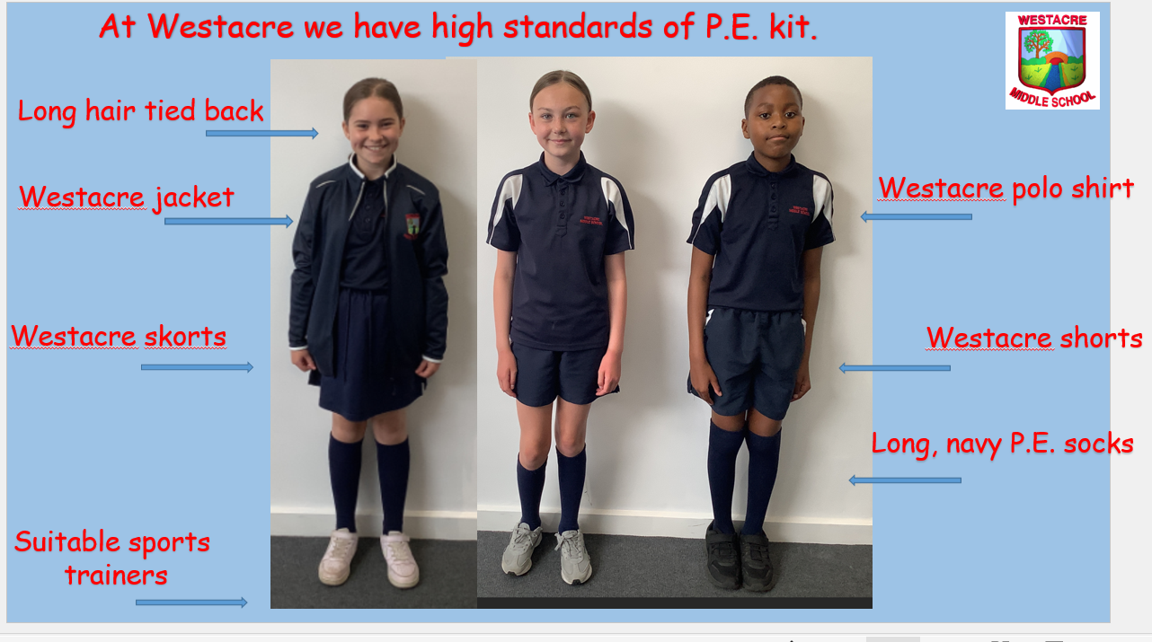
PE Kit
Tuesday | Friday
5TS, 5TH | 5LT, 5JR, 5DC
Swimming in Autumn term (Tuesdays)

Slide 6
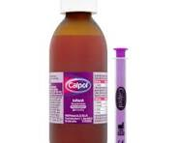

Medications
Every child who has medication or specific health or medical needs MUST have a health care plan.

Slide 7
This term’s CC topic is…Explorers
Geography: studying a range of maps and how to read them
History: who were the Maya and why were they important?
D.T.: developing a prototype and evaluating its success
Art: exploring colour-mixing primary and secondary colours using water colours
Inspire. Challenge. Achieve.

Slide 8
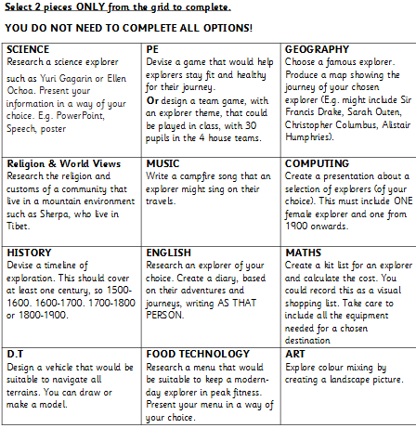
CC homework
Inspire. Challenge. Achieve.

Slide 9
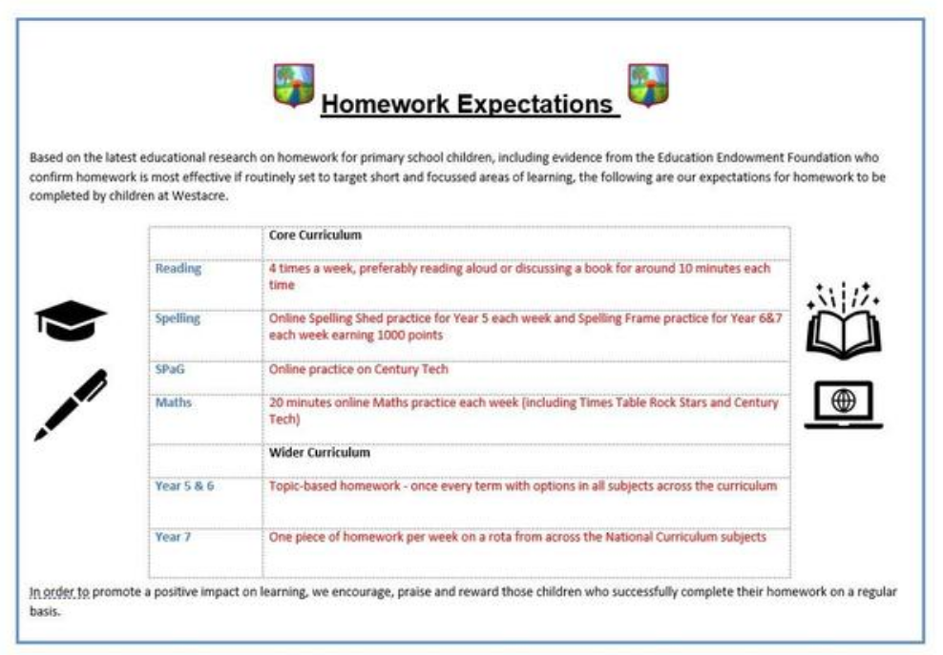
Homework
Inspire. Challenge. Achieve.

Slide 10


Recognition
Inspire. Challenge. Achieve.

Slide 11
Trips and Events
October – Explorers Day
November – Blackhole Planetarium, Year 5 disco
December – Whole school theatre trip
January – History Man
March – Hindu Temple Trip, Year 5 Quiz
May – Year 5 Film night
June – Black Country Museum

Slide 12

Catering
Breakfast club from 7:45am
Otherwise, come onto the playground from 8:15 – 8:25
Selection of items available which are free of charge (cereal, toast)
Lunches cost £2.58 (cashless)
Drinks are additional cost (water free of charge)
Inspire. Challenge. Achieve.

Slide 13
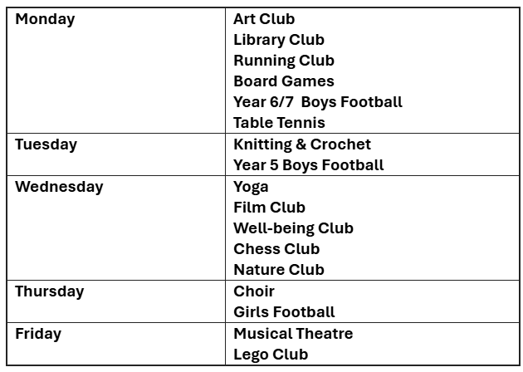
After School Clubs
Inspire. Challenge. Achieve.

Slide 14
After School Clubs
Sign up from 9th September 12:00pm until Thursday 11th 12:00pm
Children will be selected at random for a place
Parents/carers will be notified by Arbor if their child has secured a place at the club by the end of the school day on Thursday
Clubs commence from next Monday (15th September)
Any questions, please contact the school office (01905 772795 or office@westacre.worcs.sch.uk
Inspire. Challenge. Achieve.

Slide 15
Key Dates
10th September – Welcome to Year 5 Morning
12th September – school photos
29th September – Year 5 homework workshop (pm)
2nd October – Open Day and Evening
5th and 12th November – Pupil Learning Discussions
19th December – whole school theatre trip
Inspire. Challenge. Achieve.

Slide 16




Communication
Inspire. Challenge. Achieve.

Slide 17

Year 5 Website

Slide 18
Visiting the class
Reader’s Theatre
A widely used teaching strategy that exemplifies how repeated reading of texts can be used to support pupils to develop reading fluency
Inspire. Challenge. Achieve.

