Slide 1

Welcome to Year 7
Inspire. Challenge. Achieve.

Slide 2
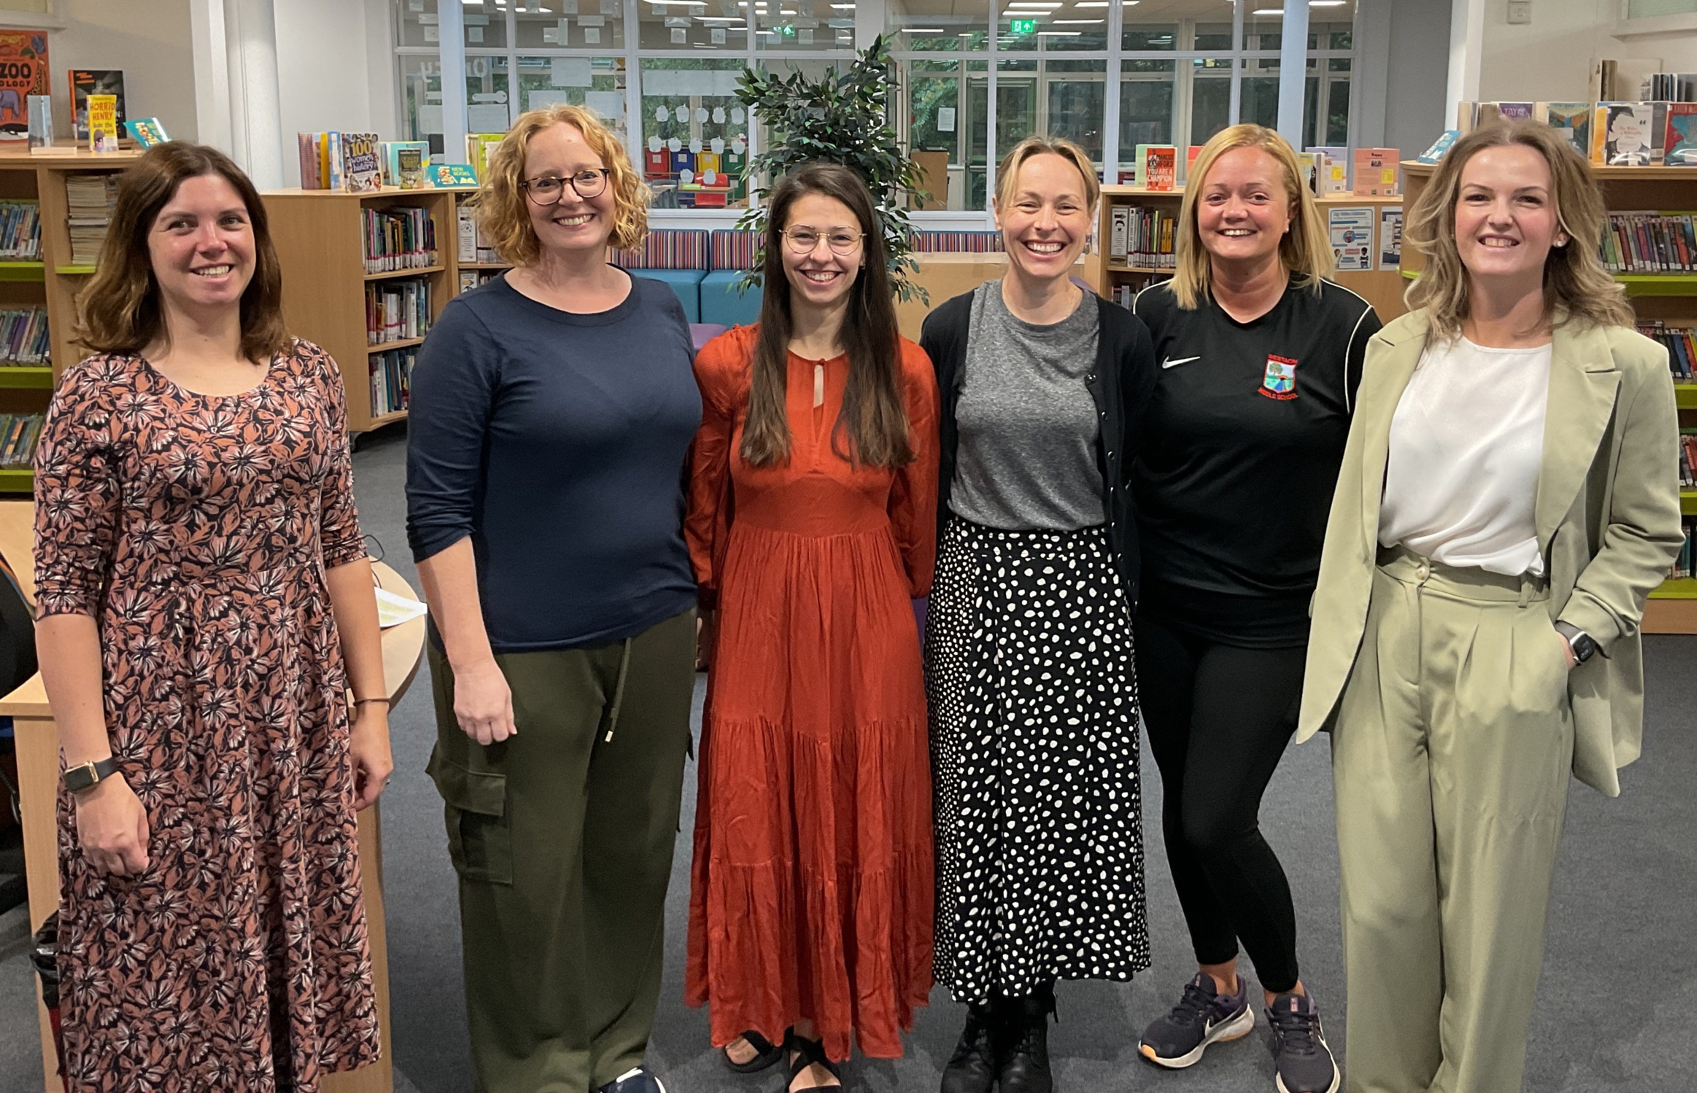
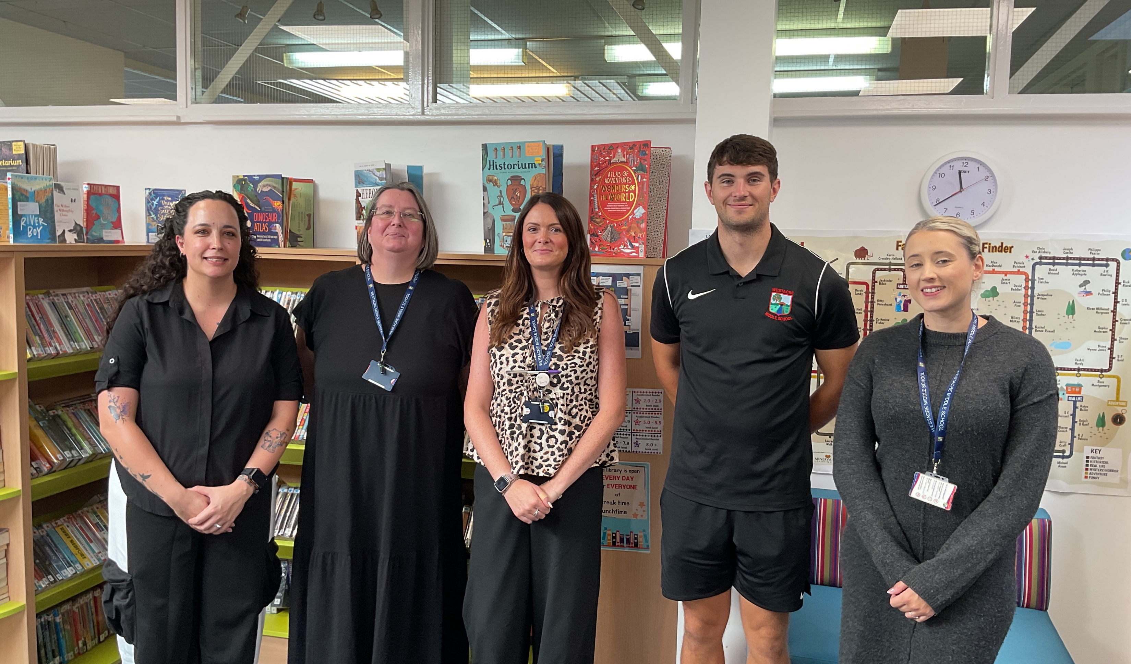
Mrs Page – Head of Year & Assistant Head
Miss Constable – 7LC
Miss Vaughan – 7LV
Mrs Barker-Miles – 7BM
Miss Majewska – 7AM
Mrs Morgan-Nickerson – 7RM
Mrs Bird – English & Maths Group
We are ably supported by many other teaching staff and teaching assistants
Meet the Year 7 Team

Slide 3
Expectations: Building on from Year 6
Punctuality and attendance
Uniform
PE Kit (days on the next slide)
Participation in all aspects of school life
Being prepared and organised
Independence – 6Rs
Homework
Inspire. Challenge. Achieve.

Slide 4
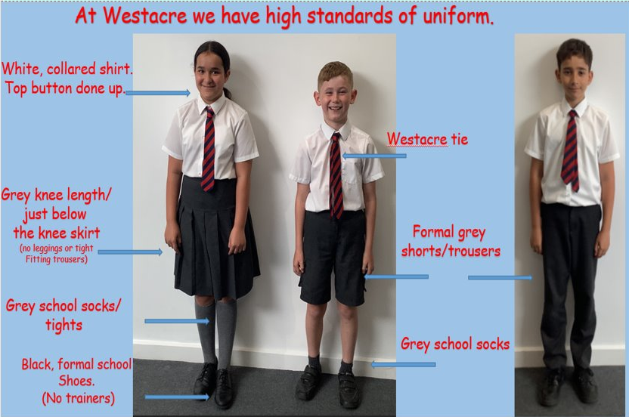
School Uniform

Slide 5
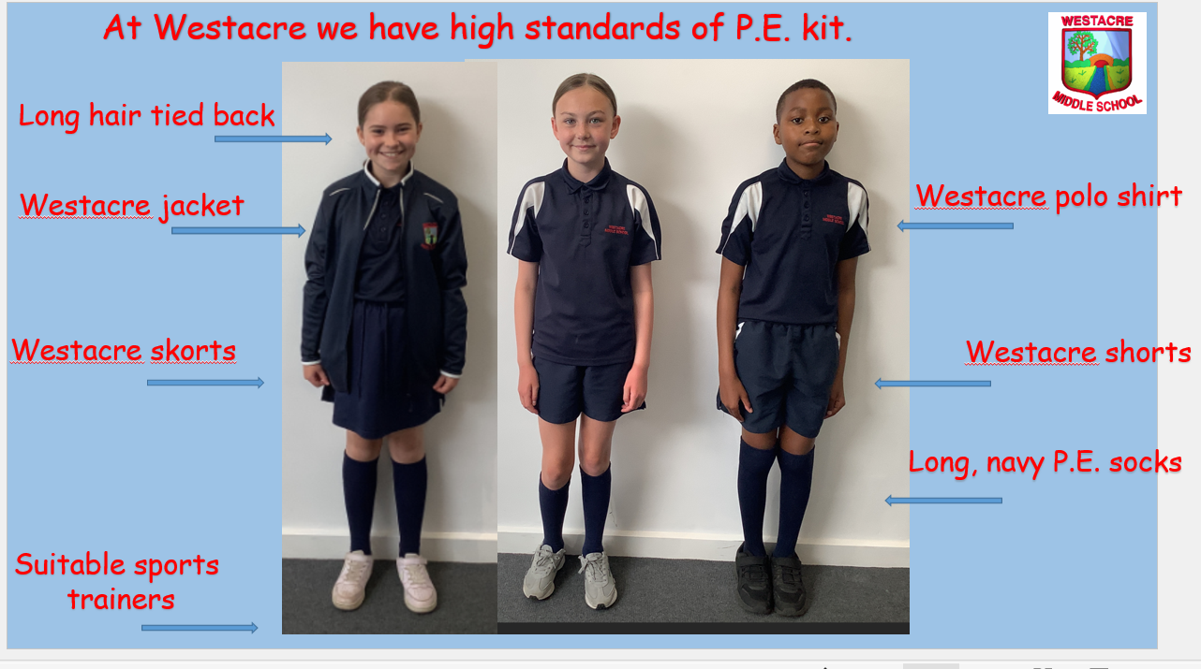
PE Kit
Monday | Wednesday | Thursday
7LV & 7BM | 7LC | 7AM & 7RM

Slide 6
What’s Different in Year 7
Pupils will now be studying the KS3 curriculum. This means that they will be studying new content as well as building on from your previous learning.
An example of this is seen in the English curriculum where there is a stronger focus on responding to texts (text analysis) in preparation for high school.
There will now be 4 lessons each of Maths and English a week and 2 French.

Slide 7
This term’s CC topic is… Conflict
History: develop a chronological understanding of the wars that shaped Britain
D.T.: making a trebuchet
English: compare 3 text to gain insight into immigration and refugees. ‘A Different Boy’
Art: artist study of Grayson Perry and a project study of postcards relating to refugees
Inspire. Challenge. Achieve.

Slide 8
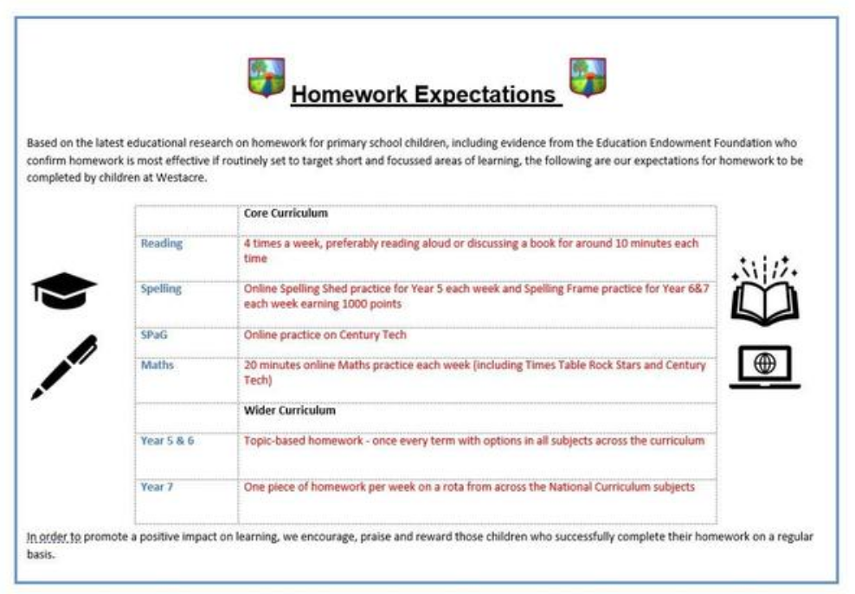
Homework
Inspire. Challenge. Achieve.

Slide 9
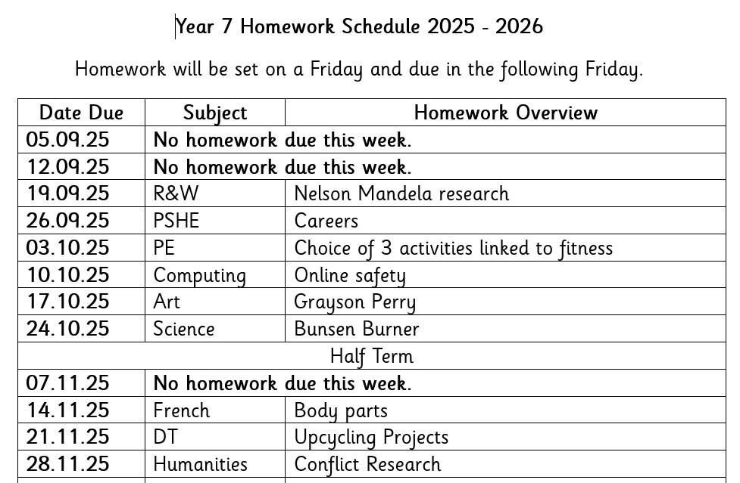
Homework
Inspire. Challenge. Achieve.

Slide 10


Recognition
Inspire. Challenge. Achieve.

Slide 11
Trips and Events
October – Commandery Trip & after school disco
December – Whole school theatre trip
February – After school quiz night
March – Skills show / 10x enterprise challenge
April – Snowdonia / Experiences week
June – Big Bang Show
July - Leaver's Celebrations: Hoody, Silent Disco, Lunch, West Midlands Safari Park

Slide 12
Year 7 Residential
Monday 20th – Friday 24th April
Extreme Outdoor Adventure Activities in Snowdonia
Meeting for parents: Tuesday 16th September at 6pm

Slide 13

Catering
Breakfast club from 7:45am
Otherwise, come onto the playground from 8:15 – 8:25
Selection of items available which are free of charge (cereal, toast)
Lunches cost £2.58 (cashless)
Drinks are additional cost (water free of charge)
Inspire. Challenge. Achieve.

Slide 14
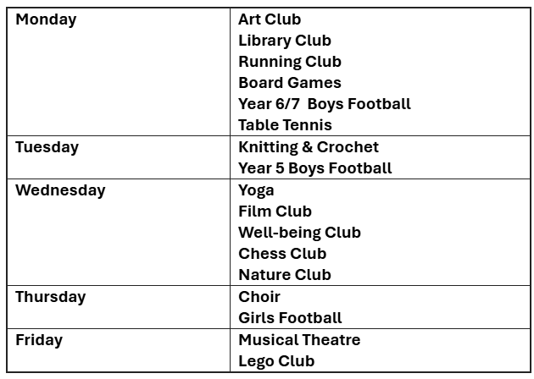
After School Clubs
Inspire. Challenge. Achieve.

Slide 15
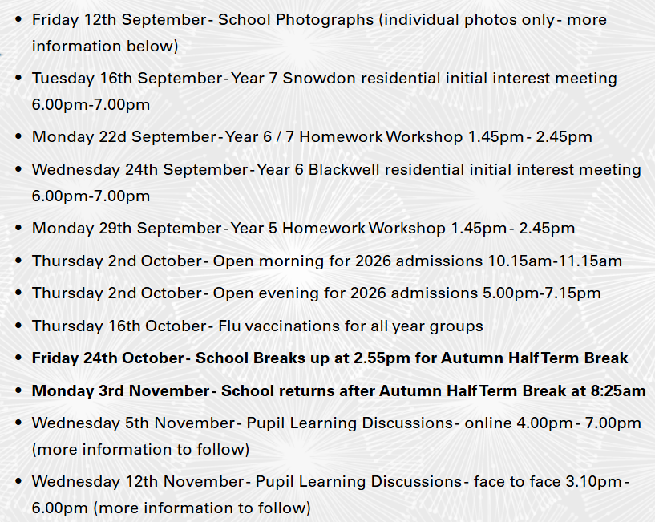
Key Dates

Slide 16




Communication
Inspire. Challenge. Achieve.

Slide 17

Year 7 Website

Slide 18
Visiting the class
Reader’s Theatre
Reader’s Theatre is a fun and engaging way for children to practise reading. Instead of memorising lines or wearing costumes, children read a text and use their voices, facial expressions, and small movements to bring the story to life.
It helps improve reading fluency, understanding, vocabulary, and confidence. Because the goal is to perform, children read the script several times, which gives them lots of practice in a meaningful way.
Inspire. Challenge. Achieve.

