Slide 1

Introducing Year 7 at Westacre Middle School
Inspire. Challenge. Achieve.

Slide 2



Introducing Year 7
Mrs Page – Head of Year
Miss Constable – 7LC
Mrs Pledger – 7LP
Mrs Underhill – 7AU
Mrs Bird & Mrs McDiarmid – 7MB
Miss Vaughan – 7LV
We are ably supported by many other teaching staff and teaching assistants.

Slide 3

Expectations: Building on from Year 6
Punctuality and attendance
Uniform
PE Kit (days on the next slide)
Participation in all aspects of school life
Being prepared and organised
Independence – 6Rs
Homework

Slide 4
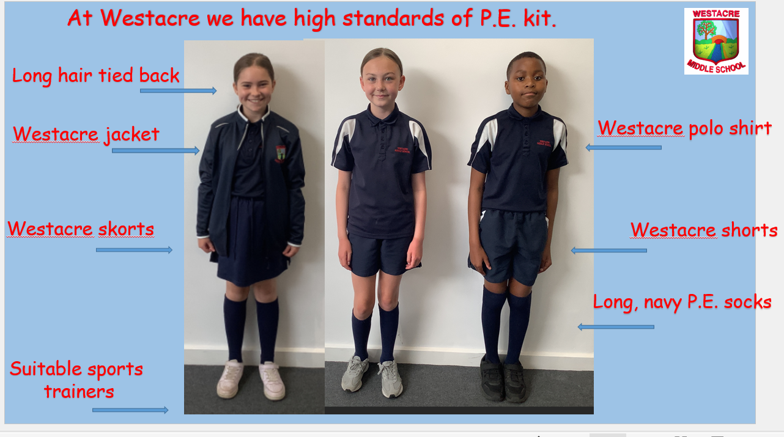
PE Kit
Monday – 7AU & 7LC
Tuesday – 7LP & 7LV
Friday – 7MB

Slide 5
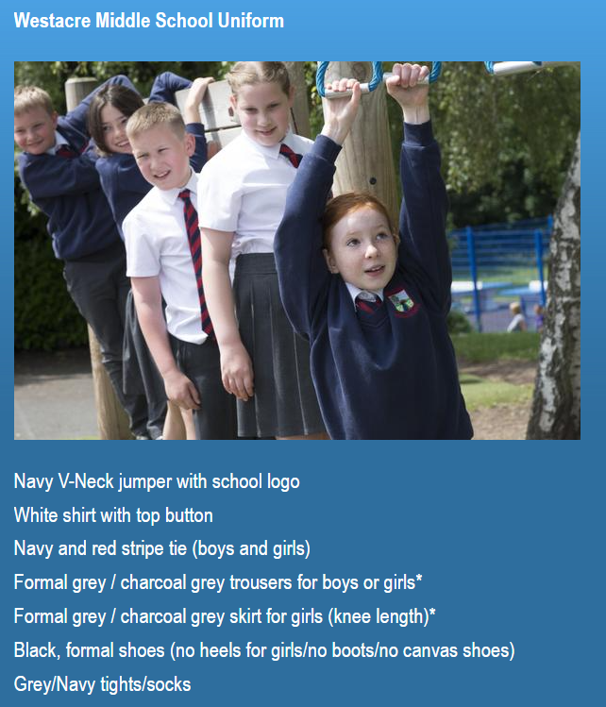
School Uniform

Slide 6
What’s different in Year 7?
Pupils will now be studying the KS3 curriculum. This means that they will be studying new content as well as building on from your previous learning.
An example of this is seen in the English curriculum where there is a stronger focus on responding to texts (text analysis) in preparation for high school.
There will now be 4 lessons each of maths and English a week and 2 French.

Slide 7

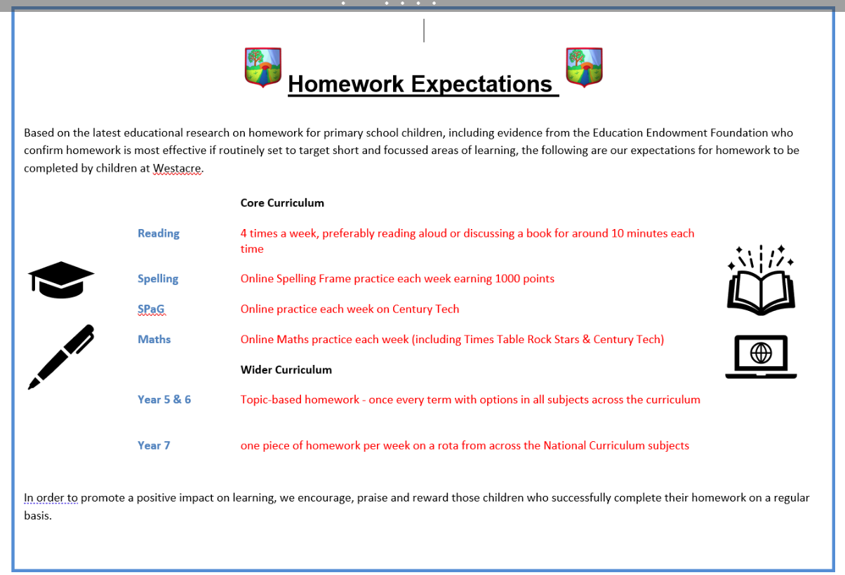
Homework

Slide 8

This term’s topic is
CONFLICT
Developing a variety of skills…
Develop a chronological understanding of the wars that shaped Britain
Understand what events led up to different conflicts including the Battle of Hastings and WW1
Developing our DT skills by making a trebuchet
Compare three texts to gain insight into immigration and refugees
Artist study of Grayson Perry and a project study of postcards relating to refugees
Curriculum Jigsaw
Inspire. Challenge. Achieve.

Slide 9
Trips / Events
October – Commandery Trip & after school disco
December – Whole school theatre trip
February – After school quiz night
March – Skills show / 10x enterprise challenge
April – Snowdonia / Experiences week
June – Big Bang Show
July - Leaver's Celebrations: Hoody, Silent Disco, Lunch, West Midlands Safari Park

Slide 10
Year 7 Residential
Monday 7th April – Friday 11th April
Extreme Outdoor Adventure Activities in Snowdonia
Meeting: Wednesday 18th September 6pm
Inspire. Challenge. Achieve.

Slide 11

Year 7 Website

Slide 12

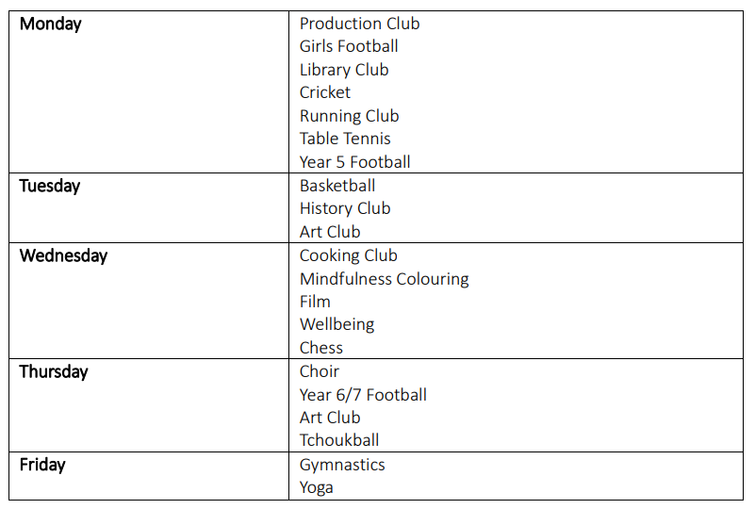
After School Clubs
Inspire. Challenge. Achieve.

Slide 13
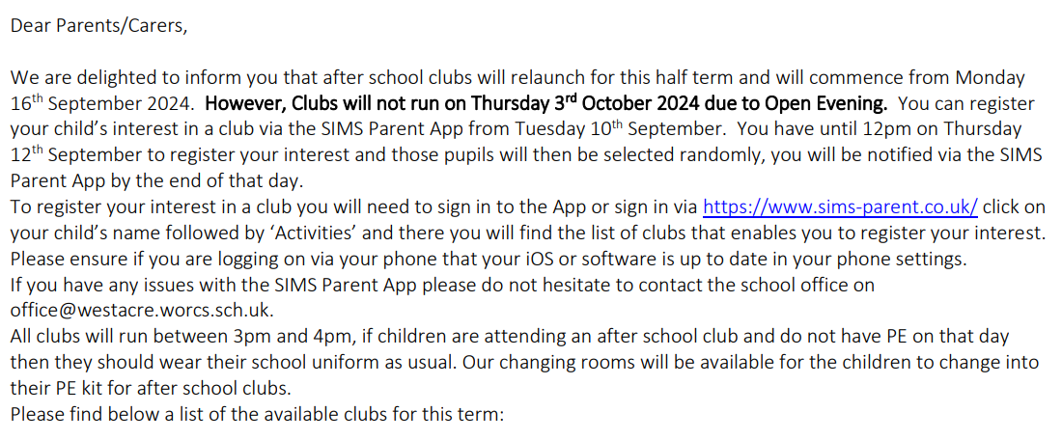
After School Clubs
Inspire. Challenge. Achieve.

Slide 14

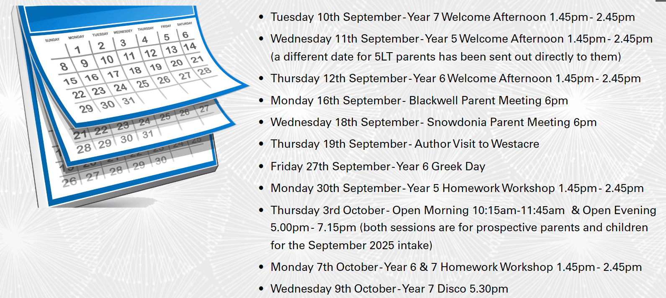
Key Dates
Inspire. Challenge. Achieve.

Slide 15




Breakfast club
Breakfast club from 7:45am
Otherwise, come onto the playground from 8:15 – 8:25
Inspire. Challenge. Achieve.

Slide 16




Communication

Slide 17
Visiting the class
What is going to happen next?
7LC – MFL
7AU – Science
7MB – Humanities
7LP – Art
7LV – PSHE
Inspire. Challenge. Achieve.

Slide 18


