Slide 1

Snowdonia national park residential
Year 7 – Mrs Page

Slide 2
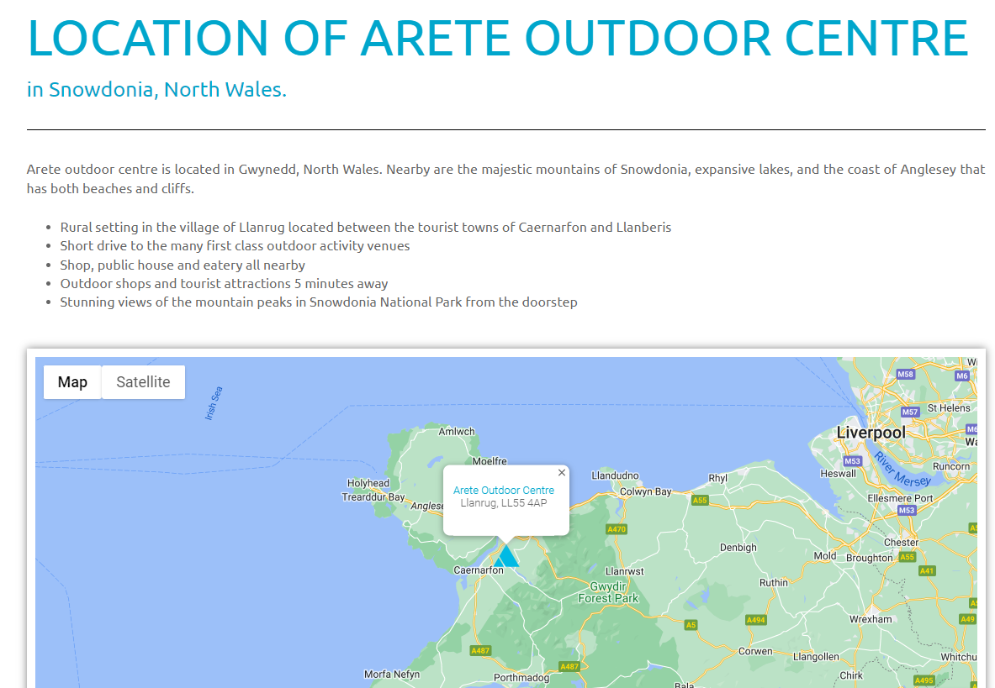

Slide 3
Who’s going?
Mrs Page – trip leader
Miss Constable – deputy trip lead
Mrs Hennessey
Mrs Truman
Others – depending on numbers.

Slide 4
Dates
Monday 7th April
Leaving school at 09:00.
Arrive at school ‘normal time’ and make your way to the sports hall
Hand all medication over to an adult.
We will be stopping half way for lunch. Please bring a packed lunch (this is on the kit list)
We should be ready to start the first activity at the centre at 1pm.
Friday 11th April
Leaving the centre at 1pm having just had lunch.
We should arrive back at school by 5pm.
I will confirm an ETA via text, on the day.
Please collect the children from the bus bay – be mindful of parking to allow the coach and minibus to park up!

Slide 5
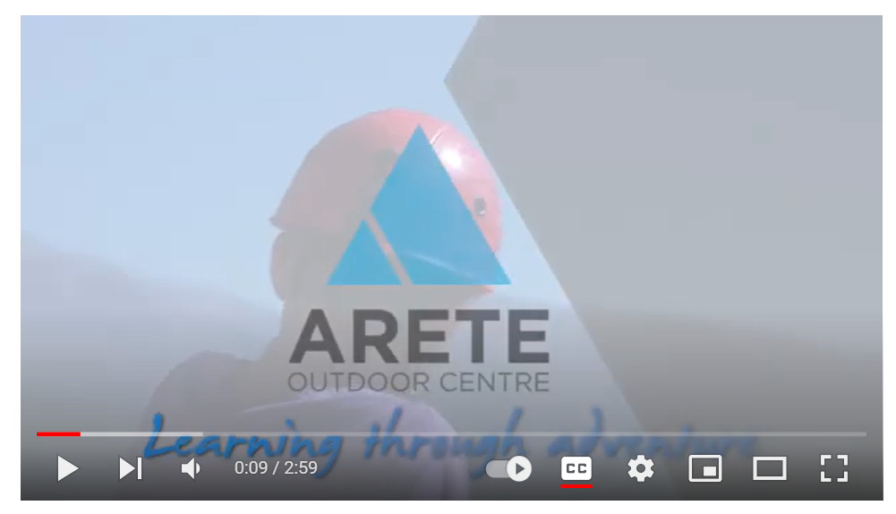
Overview of the centre

Slide 6
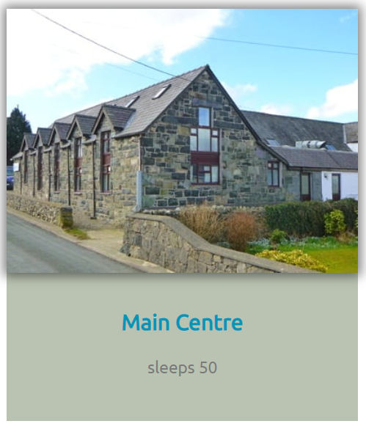
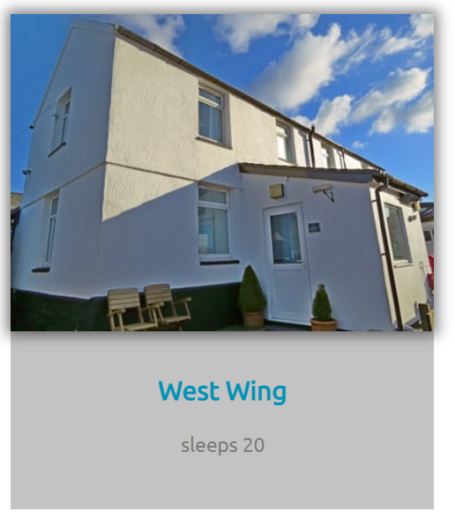
Accommodation

Slide 7
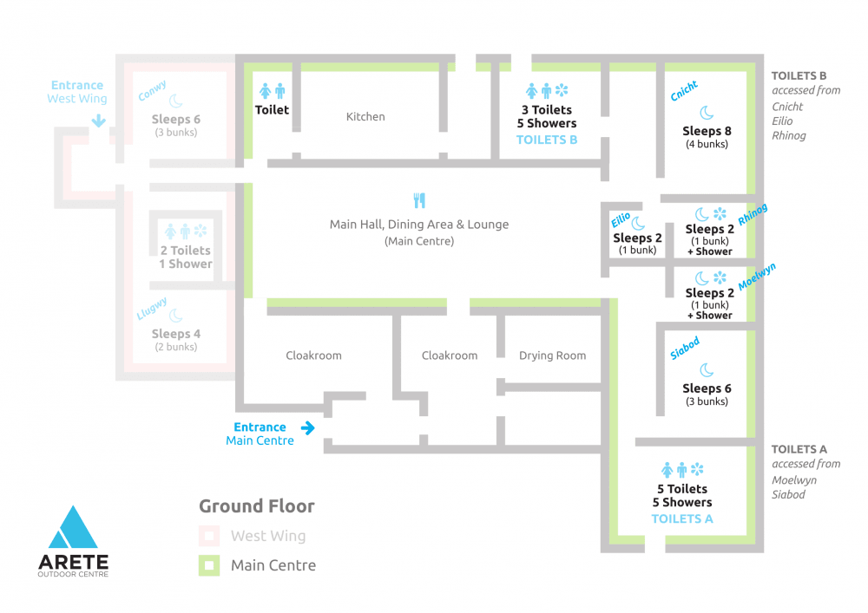

Slide 8
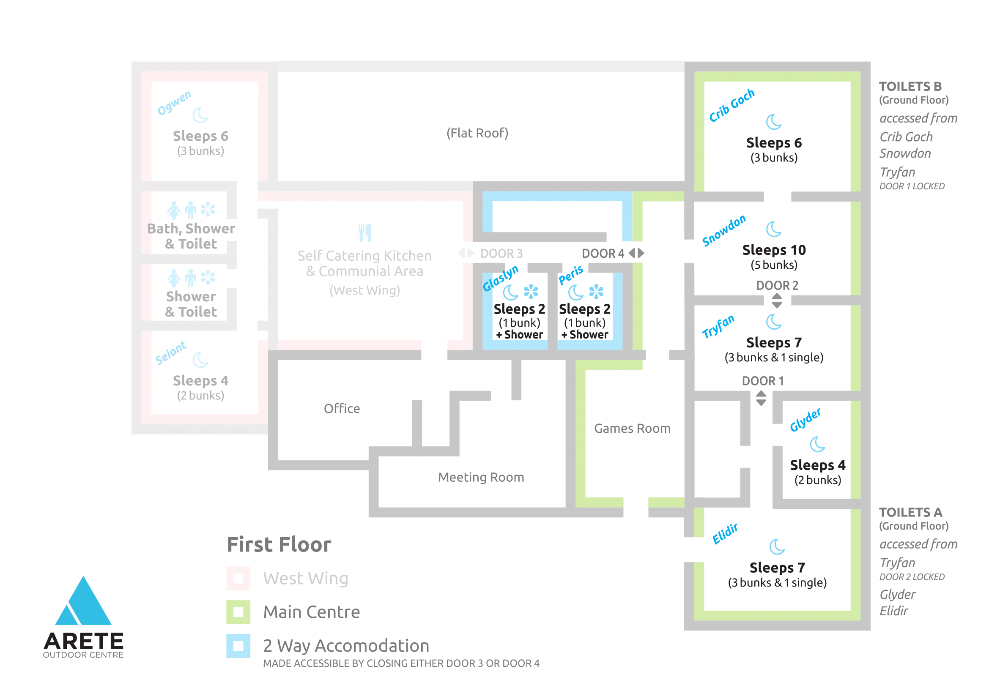

Slide 9
Land Activities
Arete Outdoor Centre is perfectly located for land based outdoor activities. The mountains of Snowdonia allow for many varied trips, from walks along ridges and through valleys to climbs and scrambles up rocky outcrops. The coastal cliff tops provide their own challenges, with crags for more technical climbing and opportunities for sea level traversing. All of these can top out in the most beautiful countryside with views a plenty! Or maybe it is a darker exploration you are after. Travel back in time to look at the history of Wales through one of our underground activities.

Slide 10
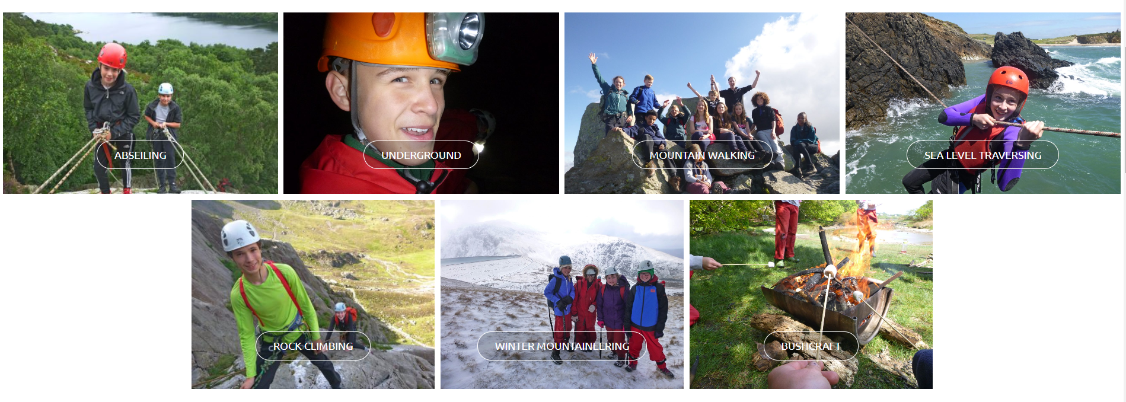

Slide 11
Water Activities
We can use the sea, rivers and mountain lakes for a range of water activities.
A small drive from the Arete Outdoor Centre is the extensive North Wales Coast. A comprehensive network of bays, inlets and open water allow for many an interesting journey by kayak. Alternatively we can provide a chance to explore the rugged coastline of Anglesey close up, scrambling and swimming our way along while coasteering.
The mountain weather also provides a good supply of water which feed the intricate river systems and lakes. The lakes in the huge valleys of Snowdonia are great for exploring using canoes or kayaks and are also a great place to practice some of your boat handling skills before moving on to the sea or rivers. The rivers provide not only great white water kayaking but the opportunity for gorge scrambling and canyoning. This combines travelling over, under and around the rocks and boulders with getting wet under waterfalls or in plunge pools.

Slide 12
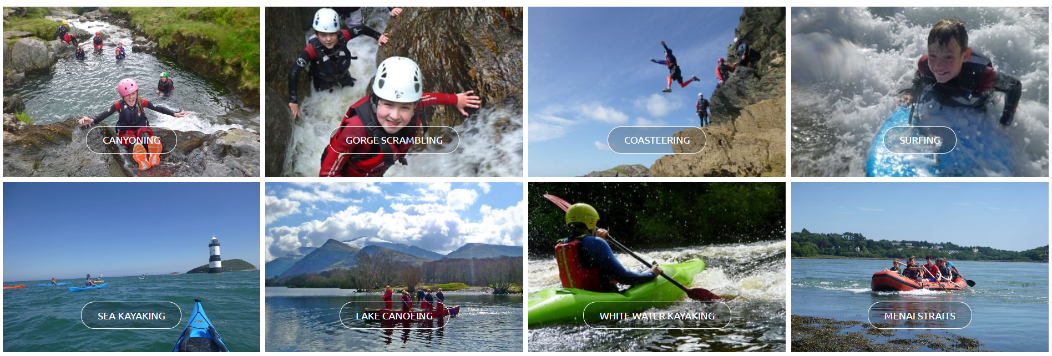

Slide 13
Groups / daily routines
So the children will be in groups of 10-12 in the day.
They will be led by the same instructor all week, along with the same member of staff from school.
The instructors are fully qualified to do everything!
The activities are very much led by the children and their ability.
The children WILL be in ‘ability’ groups and not necessarily with their best friends.
Breakfast is at 7:45am and the children will also make their lunch for the day.
They will be out on activity all day, until they come back for dinner.
After dinner, they take part in a more ‘chilled’ activity until 9pm with the instructor.
Then the children will shower, and go straight to sleep(!) ☺
Children will be able to choose who they share a dorm with.

Slide 14
Important to note
These are very adventurous activities – quite possibly not for everyone.
It is a HUGE step up from Blackwell.
There will be no option to go home if the child feels homesick – logistically we’re 4 hours away! Very experienced staff going – we have supported children every year that have felt homesick.
There isn’t really an option to ‘opt out’ of activities. Instructors work at their ability level, but they will be pushed out of their comfort zone at times.

Slide 15
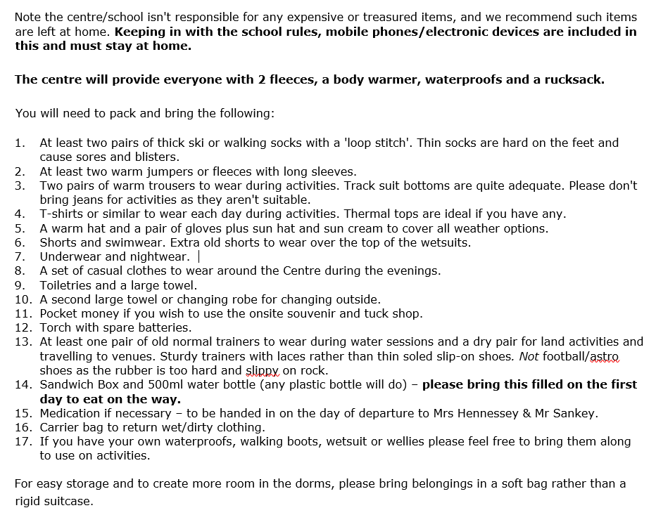
Kit List
No mobile phone / electronic devices.
Each group takes out a camera with them for the day, and we are then given a link to share the photos with you after.
NO BEDDING IS NEEDED!

Slide 16
Cost
Approximately £360
This includes the activities, accommodation, coach travel and a hoody.
This can be paid in instalments.

Slide 17
Contact with children / staff
Regular updates on the website
Text when we’ve arrived safely, and an ETA for the journey home.
Because the children won’t have their mobile phone, if you need to contact me/your child due to an emergency please contact the school in the first instance.
If it is outside of school hours, please contact the centre who will get a message to me.
School telephone number: 01905 772795
Arete outdoor centre: 01286 672136

Slide 18
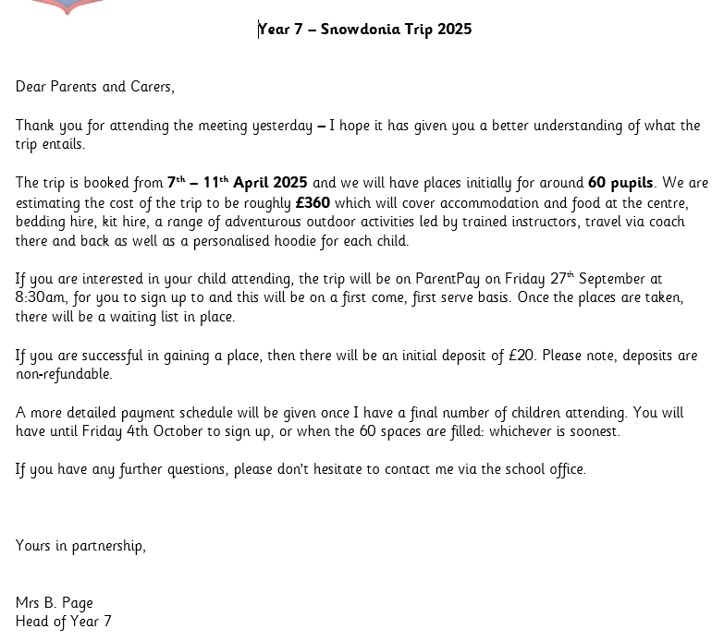

Slide 19
Thank you for coming
The staff will now walk around and answer any questions you have.

