Slide 1

Welcome to Year 6
Inspire. Challenge. Achieve.

Slide 2
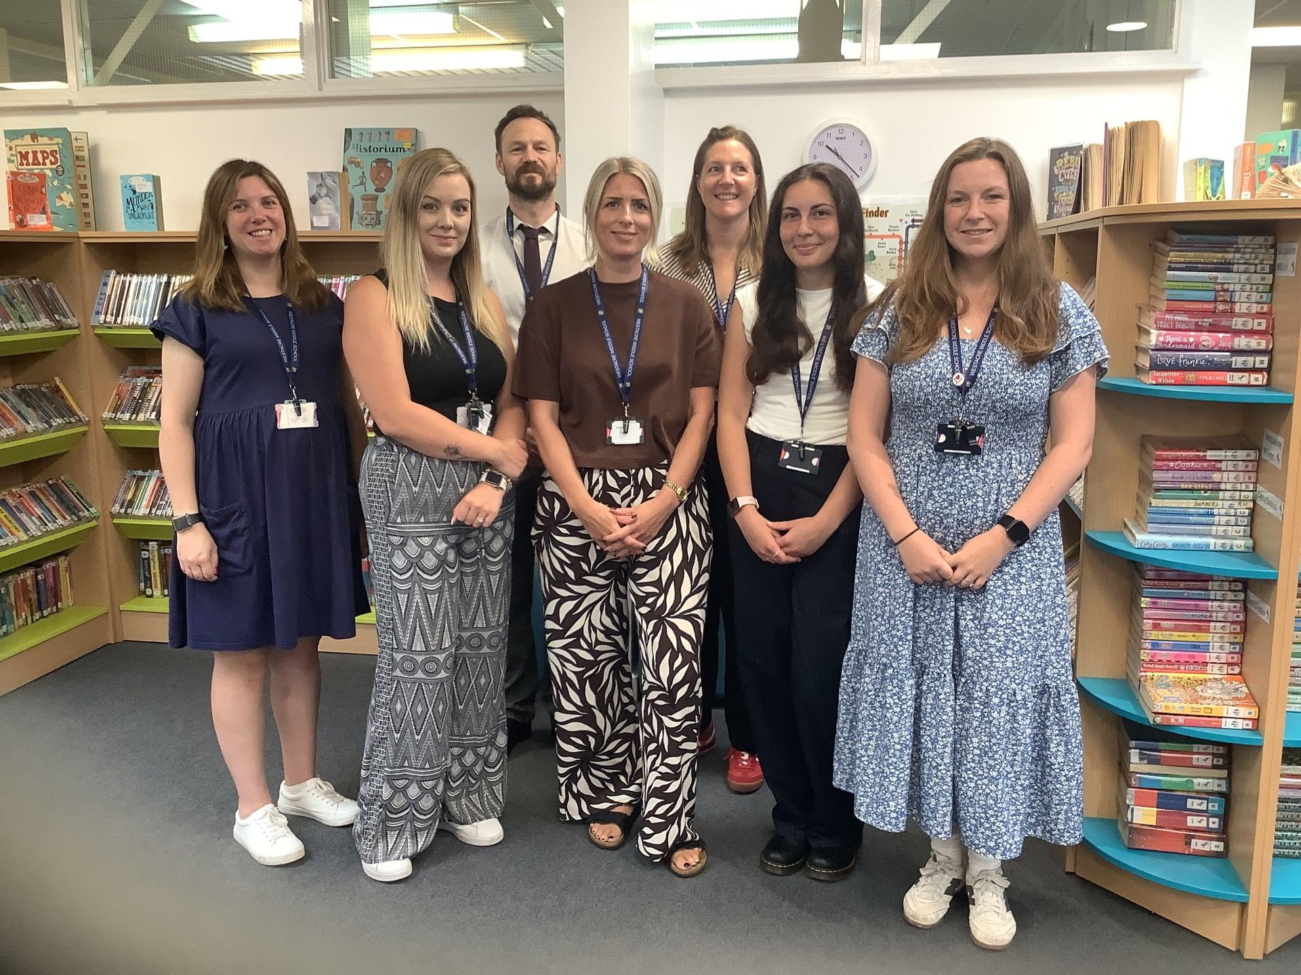
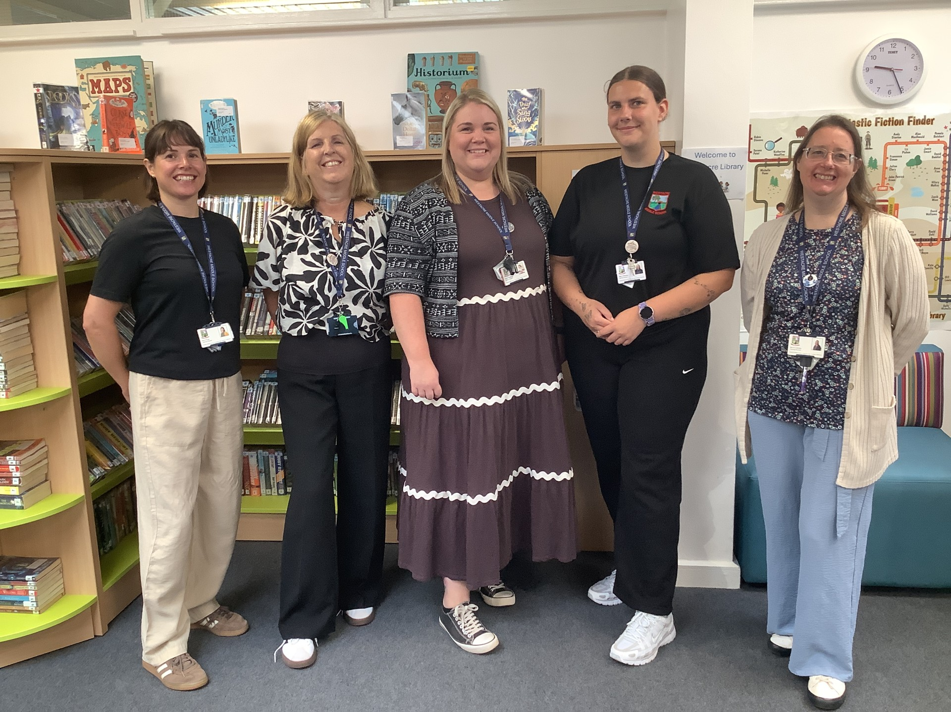
Mrs West – Head of Year
Mrs Murray & Mrs West – 6MW
Miss Dale – 6HD
Miss Gersbach – 6GG
Mr Treadwell – 6JT
Mrs Holden – 6LH
Mrs Ardis – English & Maths Group
Mrs Barker-Miles – English and Maths support
We are very well supported by many other teaching staff and teaching assistants
Meet the Year Team

Slide 3
Expectations: Building on from Year 5
Punctuality and attendance
Uniform
PE Kit (days on the next slide)
Participation in all aspects of school life
Being prepared and organised
Independence – 6Rs
Homework
Inspire. Challenge. Achieve.

Slide 4
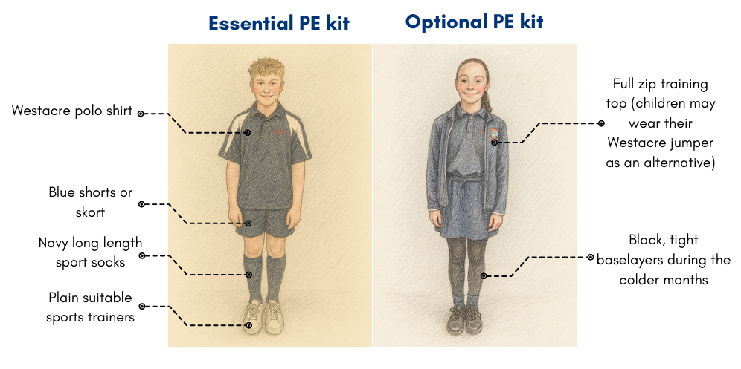
PE Kit
Thursday | Friday
6MW, 6HD | 6JT, 6LH, 6GG

Slide 5
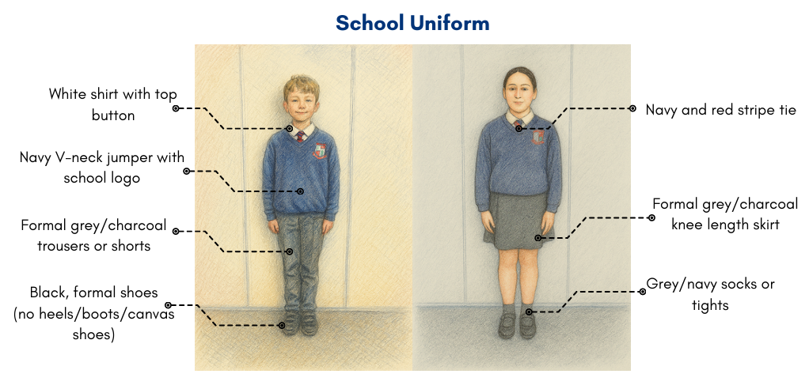
School Uniform

Slide 6

Catering
Breakfast club from 7:45am
Otherwise, come onto the playground from 8:15 – 8:25
Selection of items available which are free of charge (cereal, toast)
Lunches cost £2.70 (cashless)
Drinks are additional cost (water free of charge)
Inspire. Challenge. Achieve.

Slide 7
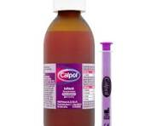

Medications
Every child who has medication or specific health or medical needs MUST have a health care plan.

Slide 8
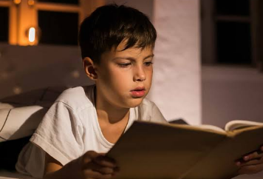



Homework
Inspire. Challenge. Achieve.

Slide 9


Recognition
Inspire. Challenge. Achieve.

Slide 10

Wrap Around Care

Slide 11
Trips and Events
October – After school disco
December – Whole school theatre trip/ Cathedral Trip
January – Bingo Night
February – Whipsnade Zoo virtual Trip
April – Bishops Wood Trip
June – Quiz Night
July – Blackwell Residential/ Survival Week

Slide 12
Key Dates
Friday 11th September - School Photographs
Monday 21st September - Year 6 and 7 Homework shop 1.45pm-2.45pm
Thursday 1st October - Open evening for 2027 admissions 5.00pm-7.15pm
Tuesday 6th October - Year 6 Disco 5.00pm-6.30pm
Thursday 22nd October - Term Ends
Friday 23rd October - Teacher Education Day
Monday 26th October to Friday 30th October - Half Term
Wednesday 9th December - Christmas Performance 1:30pm-2:30pm
Wednesday 9th December - Christmas Performance 6-7pm
Wednesday 16th December - Christmas Lunch Day
Thursday 17th December - Theatre Trip to Peter Pan
Friday 18th December - End of Term
Monday 4th January - Teacher Education Day
Tuesday 5th January - Spring Term Begins
Wednesday 28th January – SATs Parent afternoon ( 2.00pm – 2.50pm) and evening (6.00pm – 7.00pm)
Monday 10th May – Thursday 13th May – KS2 Statutory Assessment Tests (SATs)

Slide 13




Communication
Inspire. Challenge. Achieve.

Slide 14
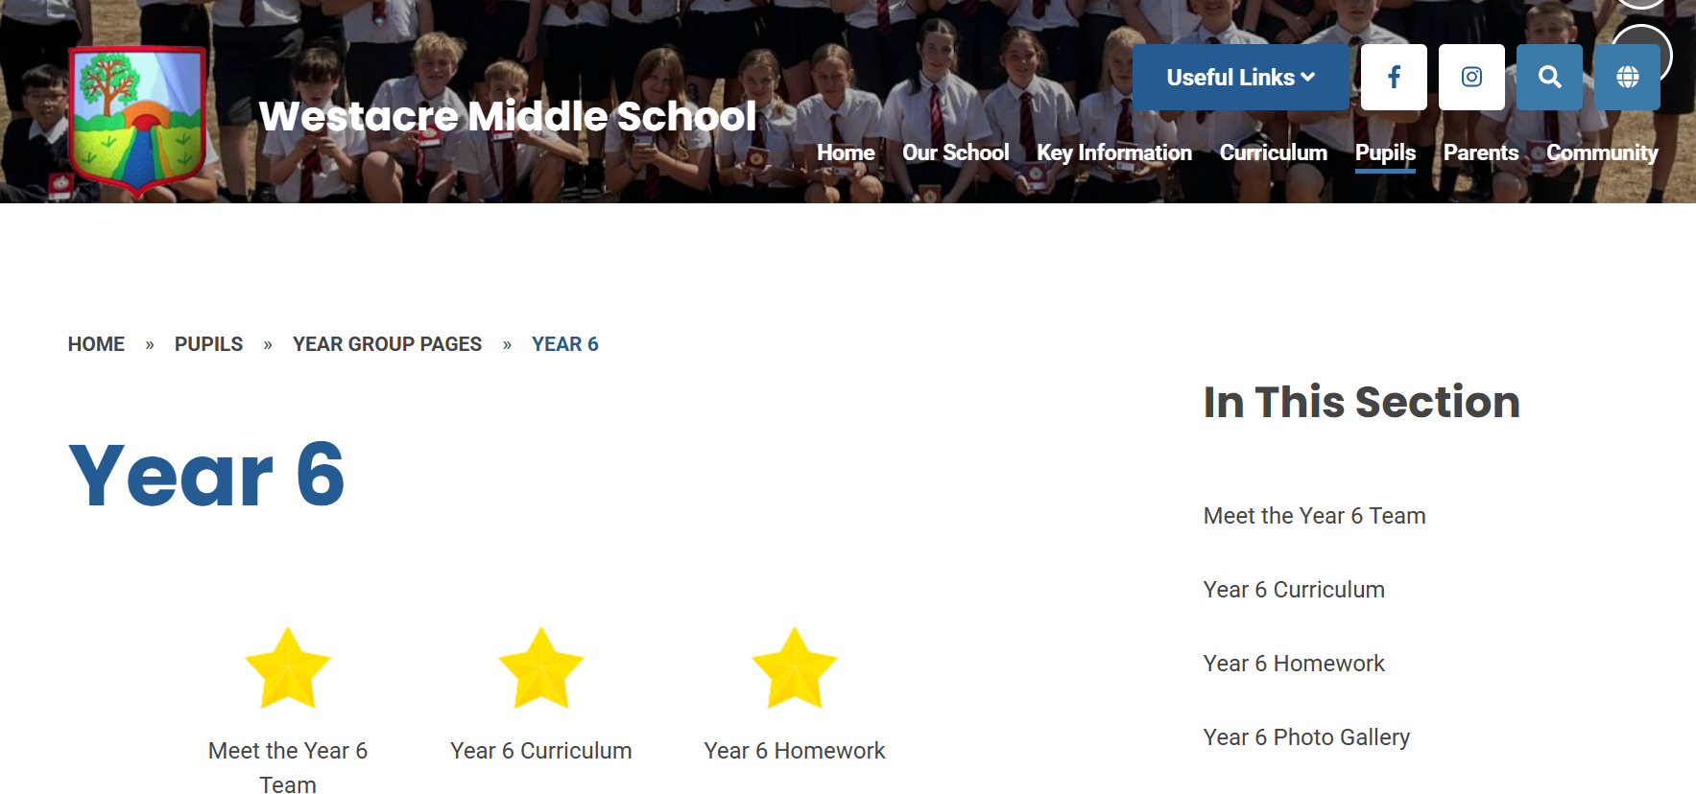
Year 6 Website

Slide 15
Visiting the class
Reader’s Theatre
A widely used teaching strategy that exemplifies how repeated reading of texts can be used to support pupils to develop reading fluency
6MW, 6HD, 6GG, 6JT, 6LH, The Lodge (Mrs Ardis)
Inspire. Challenge. Achieve.

